Slide 1
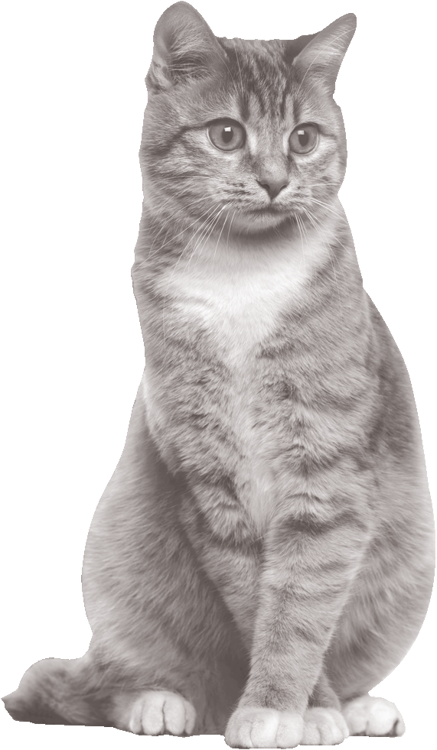
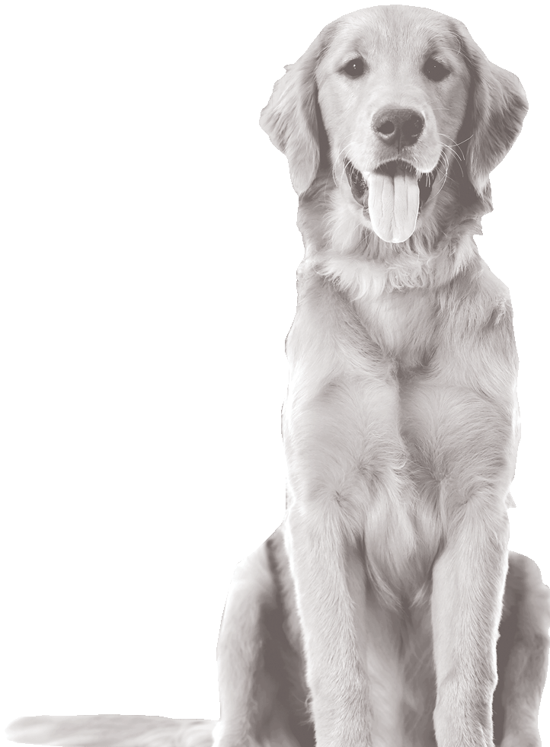
The only pet food owned by independent pet stores
ULTRA PREMIUM, ALL NATURAL, 100% OF KIBBLE MADE IN USA

Slide 2
The partners who own this food all have locally-owned pet businesses
Men & women who have devoted their lives to pets
ULTRA PREMIUM, ALL NATURAL, 100% OF KIBBLE MADE IN USA

Slide 3
As a result, we answer only to our partner stores’ customers—pet owners—not to outside shareholders
With us, what’s good for pets comes first, profits come after that
ULTRA PREMIUM, ALL NATURAL, 100% OF KIBBLE MADE IN USA

Slide 4
“It’s a small privately-owned company” is a selling point
for our food
People trust independent businesses most
Grandma Mae’s has never had a recall
ULTRA PREMIUM, ALL NATURAL, 100% OF KIBBLE MADE IN USA

Slide 5
Our dry food production facilities belong to a three-generation family-owned company with the strictest standards and tests
for ingredients
ULTRA PREMIUM, ALL NATURAL, 100% OF KIBBLE MADE IN USA

Slide 6
All product is made fresh in small batches with the highest quality fresh ingredients
The palatability is amazing and you will have almost no returns from customers who try it
ULTRA PREMIUM, ALL NATURAL, 100% OF KIBBLE MADE IN USA

Slide 7
We don’t want to make huge quantities in different plants all over the world
We only want to make the quantities we can make at the highest level of quality & consistency
ULTRA PREMIUM, ALL NATURAL, 100% OF KIBBLE MADE IN USA

Slide 8
This is why we can give your company an exclusive all your areas—to be your “house brand”
We won’t sell to mass merchants, Petco/PetSmart, Tractor Supply, Pet Supplies Plus, Pet Sense, Pet Club or other national chains
ULTRA PREMIUM, ALL NATURAL, 100% OF KIBBLE MADE IN USA

Slide 9
We don’t sell Chewy.com or other websites that undercut you
Internet competition is the biggest threat to brick & mortar retail success
We protect you from websites better than any other brand of pet food
ULTRA PREMIUM, ALL NATURAL, 100% OF KIBBLE MADE IN USA

Slide 10
When you recommend Country Naturals to a customer, she is guaranteed to remain your customer
Studies show customers are buying store brands more in every field and have confidence in them
ULTRA PREMIUM, ALL NATURAL, 100% OF KIBBLE MADE IN USA

Slide 11
WHY
IS BETTER
Not all Ingredients are the Same Quality
Ingredients with the same name can be very different! One chicken meal could be 50% protein, another could be 65%
We buy only the highest quality ingredients
that are only available in small quantities
Better-quality muscle and organ meats and high-protein
meals have higher levels of Taurine and and other
key nutrients
Unique Cooking Process Compared to Larger Brands
Our kibble is made with a unique low-temp, slow cooking process that a big brand can’t use
This process maintains higher levels of Taurine and amino acids
Thus pets are more likely to remain healthy: they’ll get more nutrition from less food and their stools will be smaller.
ULTRA PREMIUM, ALL NATURAL, 100% OF KIBBLE MADE IN USA

Slide 12
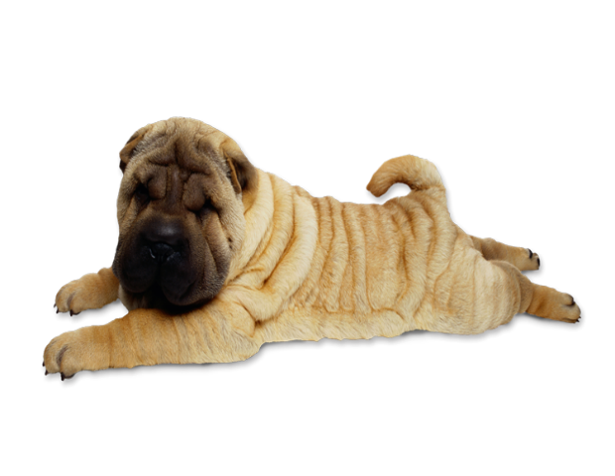
WHY
IS BETTER
And Prevents DCM Three Ways
We supplement all our foods to a high level of Methionine, which prevents diminished Taurine levels in dogs
This, plus higher quality ingredients and the slow-cook low-temp process are thee reasons why Grandma Mae’s helps prevent many canine health issues including DCM
Of the 450+ cases reported to the FDA by mid-2019, zero dogs were feeding Grandma Mae’s
Strictest Ingredient Testing & Certification
As a small company we can maintain stricter quality
controls, shorter lead times and perform extra tests
on all our ingredients
Our facilities are among the most highly certified in the USA, they are EU (European Union) certified, meaning that all meat must come from animals that pass additional inspections
Many other premium foods do not meet these standards
ULTRA PREMIUM, ALL NATURAL, 100% OF KIBBLE MADE IN USA

Slide 13
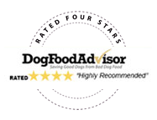
The only pet food owned by independent pet stores
and their co-op
The Reviewers Agree:
ULTRA PREMIUM, ALL NATURAL, 100% OF KIBBLE MADE IN USA

Slide 14
The only pet food owned by independent pet stores
Great for Picky Eaters and Sensitive Stomachs—
Over 70% of Protein from Animal Sources
NO Corn, Soy, Wheat, Gluten, Dairy,
or Ethoxyquin
NO artificial preservatives,
colors, flavors, or fillers
Converting to 100% Sustainable
Packaging in 2019-2020
Grandma Mae’s has never had a recall
ULTRA PREMIUM, ALL NATURAL, 100% OF KIBBLE MADE IN USA

Slide 15
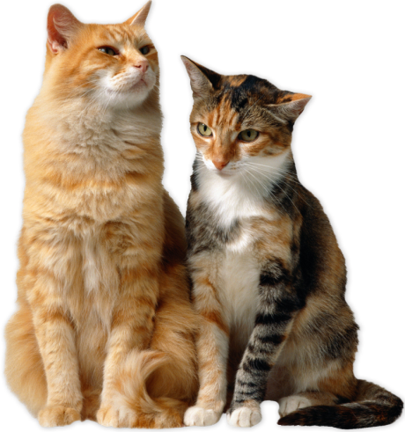
THE STORY OF
Grandma Mae’s Country Naturals was founded in 2007 when a group of independent pet store owners met to discuss what was happening in the pet food industry.
They were concerned that many of the best premium food brands were being acquired by large corporations— leading to a decline in quality and nutrition, and an increase in prices.
ULTRA PREMIUM, ALL NATURAL, 100% OF KIBBLE MADE IN USA

Slide 16
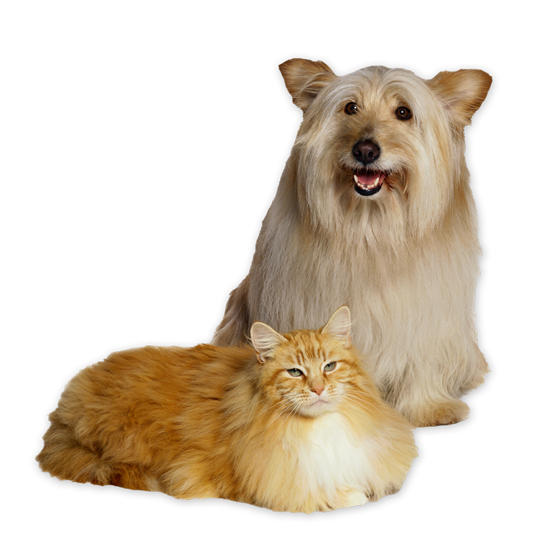
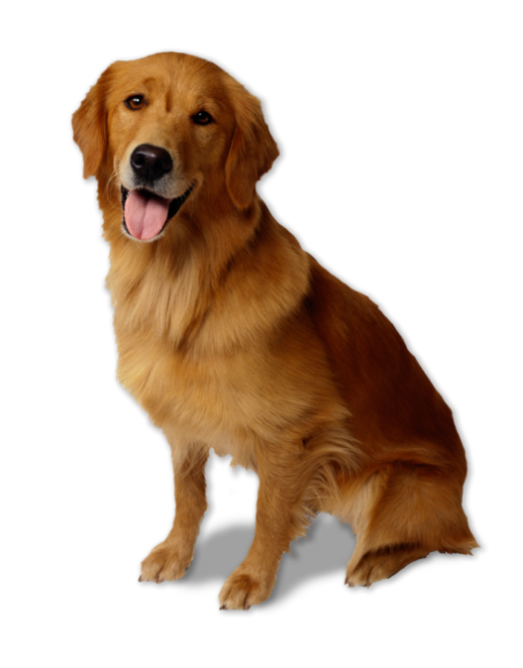
THE STORY OF
To provide their customers with a product of the quality they wanted, these small business owners pooled their funds to start the only independent-retailer owned pet food
Today, the need for Country Naturals is greater than ever. The trend of buyouts of premium food companies continues
Competition on premium pet food is even fiercer with supermarkets getting in & Amazon & Chewy.com selling their own brands
ULTRA PREMIUM, ALL NATURAL, 100% OF KIBBLE MADE IN USA

Slide 17
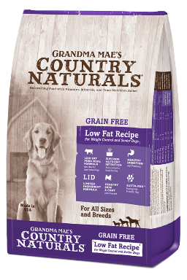
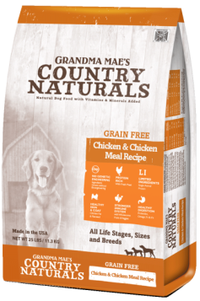
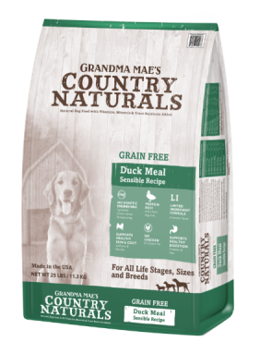
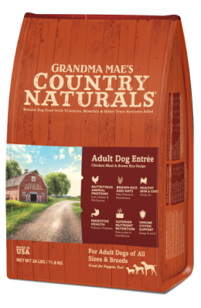
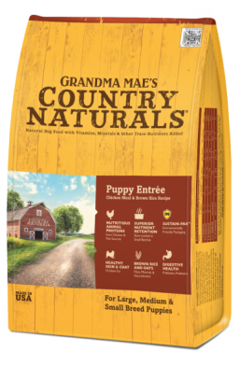
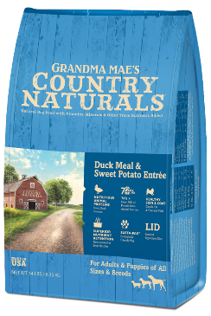
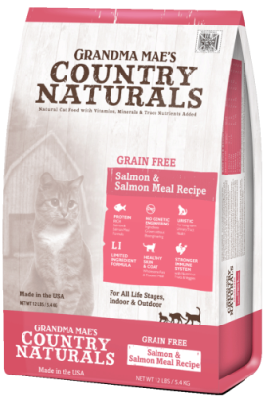
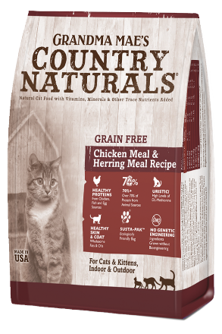
Overview of Dry Food Products
Ten Grain Free Dog Foods, including:
Seven Grain-Inclusive Dog Foods, including:
Four Dry Cat Foods, including:

Slide 18
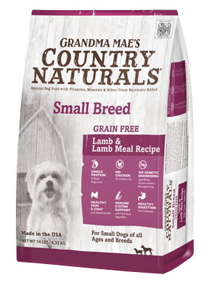
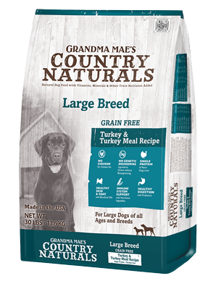
Grain Free AND Chicken Free Formulas for special groups of dogs
Many customers now prefer grain free
Many of these same customers also want to start avoiding chicken
Most Small Breed, Large Breed and Low Fat Formulas are not GRAIN FREE & CHICKEN FREE
but the formulas from
Grandma Mae’s are both

Slide 19
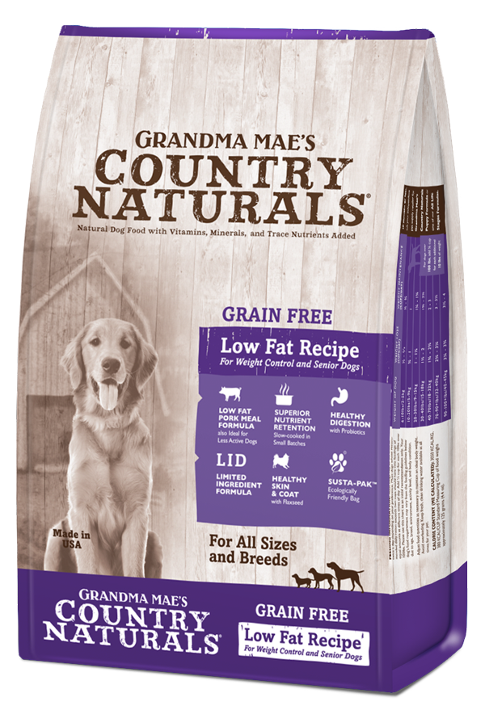
Grain Free Non-GMO Low Fat
For Weight Control, Seniors
& Low Activity Dogs
Non-GMO Single Protein
Glucosamine & Chondroitin Added
Lean Pork, No White Potatoes Protein 23% Fat 7-9%
Separate Feeding Charts for weight loss and weight maintenance
Available in: 4lb, 14lb and 25lb bags
(1.8 kg, 6.35 kg, 11.34 kg)

Slide 20
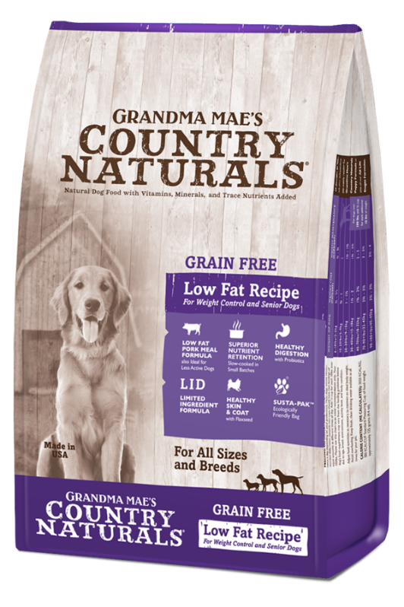
Grain Free Non-GMO Low Fat Ingredients
Pork Meal, Chickpeas, Lentils, Yellow Peas, Tapioca, Sweet Potatoes, Natural Flavor, Flaxseed, Suncured Alfalfa Meal, Dried Kelp, Menhaden Fish Oil, Carrots, Parsley, Lettuce, Chicken Fat (free from chicken protein), Watercress, Spinach, Celery, Choline Chloride, Glucosamine Hydrochloride, Chondroitin Sulfate, Calcium Carbonate, Monosodium Phosphate, Dried Lactobacillus acidophilus Fermentation Product, Dried Bacillus subtilis Fermentation Product, Dried Bifidobacterium thermophilum Fermentation Product, Dried Bifidobacterium longum Fermentation Product, Dried Enterococcus faecium Fermentation Product, Chelated Zinc Proteinate, Vitamin E Supplement, Zinc Sulfate, Selenium Yeast, Ferrous Sulfate, Chelated Copper Proteinate, Chelated Manganese Proteinate, Vitamin A Supplement, Copper Sulfate, Niacin, Pantothenic Acid, Vitamin B12 Supplement, Manganese Sulfate, Riboflavin, Biotin, Vitamin D3 Supplement, Chelated Cobalt Proteinate, Thiamine Mononitrate, Folic Acid, Calcium Iodate.
Total Microorganisms* 3.5x10⁵ CFU/lb MIN
Guaranteed Analysis
Crude Protein: 26% min. Crude Fat: 7.0% min. 9.0% max. Crude Fiber: 5.0% max.
3050 KCAL/KG ME
380 KCAL/CUP

Slide 21
Grain Free Non-GMO Large Breed Turkey
For Large Dogs of all ages and breeds over 80 pounds as adults, and for puppies up to 2 years
Non-GMO Single Protein
Fresh turkey is the first ingredient!
Available in: 14 lb and 30 lb bags
(6.35 kg and 13.6 kg)

Slide 22
Grain Free Non-GMO Large Breed Turkey Ingredients
Turkey, Turkey Meal, Chickpeas, Lentils, Peas, Canola Oil, Tapioca, Flaxseed Meal, Suncured Alfalfa Meal, Menhaden Fish Oil, Dried Kelp, Carrots, Parsley, Lettuce, Watercress, Spinach, Celery, DL-Methionine, Choline Chloride, Calcium Carbonate, Monosodium Phosphate, Dried Lactobacillus acidophilus Fermentation Product, Dried Bacillus subtilis Fermentation Product, Dried Bifidobacterium thermophilum Fermentation Product, Dried Bifidobacterium longum Fermentation Product, Dried Enterococcus faecium Fermentation Product, Zinc Proteinate, Vitamin E Supplement, Niacin, Zinc Sulfate, Ferrous Sulfate, Riboflavin, Copper Proteinate, Manganese Proteinate, Vitamin A Supplement, Copper Sulfate, d-Calcium Pantothenate, Vitamin B12 Supplement, Manganese Sulfate, Biotin, Vitamin D3 Supplement, Cobalt Proteinate, Thiamine Mononitrate, Folic Acid, Sodium Selenite, Calcium Iodate.
Total Microorganisms* 3.5x10⁵ CFU/lb MIN
Guaranteed Analysis
Crude Protein: 25% min. Crude Fat: 12% min. Crude Fiber: 4.5% max.
3450 KCAL/KG ME
430 KCAL/CUP

Slide 23
Grain Free Non-GMO Small Breed Lamb
For Small Dogs of all ages and Breeds
Non-GMO Single Protein
Beneficial Oils & Flaxseed Meal
for Healthy Skin & Coat
Fresh Lamb and Lamb Meal are the first two ingredients
Available in: 4lb and 14lb bags
(1.8 kg and 6.35 kg)

Slide 24
Grain Free Non-GMO Small Breed Lamb Ingredients
Lamb, Lamb Meal, Lentils, Chickpeas, Peas, Canola Oil, Flaxseed Meal, Suncured Alfalfa Meal, Pea Protein, Menhaden Fish Oil, Dried Kelp, Carrots, Parsley, Lettuce, Watercress, Spinach, Celery, DL-Methionine, Choline Chloride, Calcium Carbonate, Monosodium Phosphate, Dried Lactobacillus acidophilus Fermentation Product, Dried Bacillus subtilis Fermentation Product, Dried Bifidobacterium thermophilum Fermentation Product, Dried Bifidobacterium longum Fermentation Product, Dried Enterococcus faecium Fermentation Product, Zinc Proteinate, Vitamin E Supplement, Niacin, Zinc Sulfate, Ferrous Sulfate, Riboflavin, Copper Proteinate, Manganese Proteinate, Vitamin A Supplement, Copper Sulfate, d-Calcium Pantothenate, Vitamin B12 Supplement, Manganese Sulfate, Biotin, Vitamin D3 Supplement, Cobalt Proteinate, Thiamine Mononitrate, Folic Acid, Sodium Selenite, Calcium Iodate.
Total Microorganisms* 3.5x10⁵ CFU/lb MIN
Guaranteed Analysis
Crude Protein: 24% min. Crude Fat: 12% min. Crude Fiber: 4% max.
3280 KCAL/KG ME
410 KCAL/CUP

Slide 25
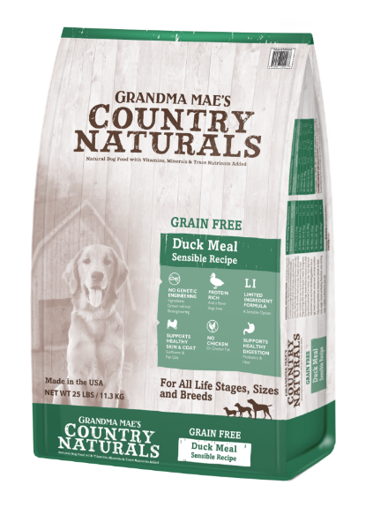
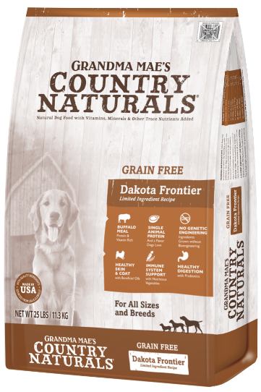
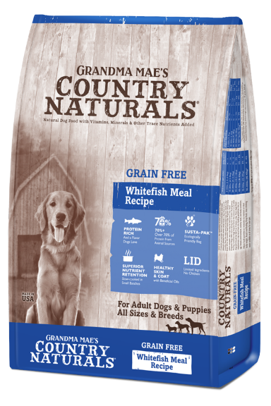
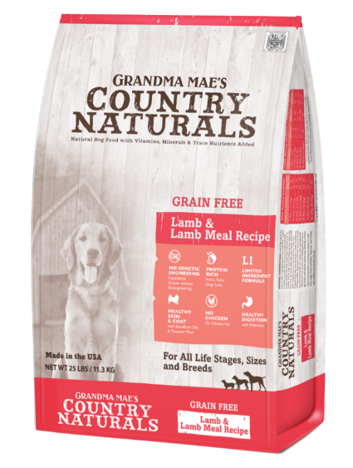
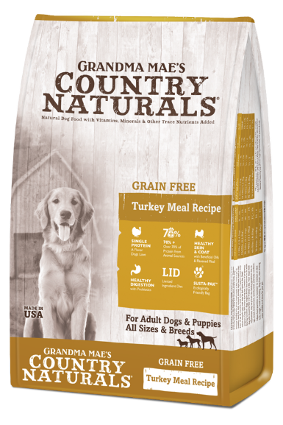
Grain Free Rotational Diets
Single protein, limited ingredient diets
No potatoes for lower glycemic index
Non-GMO
For all life stages, sizes and breeds

Slide 26
Grain Free Non-GMO Dakota Frontier Buffalo
For Adult Dogs of all Sizes, and Breeds
Non-GMO Single Protein
Easily digestible, lean Buffalo Meal is the first ingredient
Novel protein, great for allergy avoidance
Available in: 4lb, 14lb and 25lb bags
(1.8 kg, 6.35 kg, and 11.34 kg)

Slide 27
Grain Free Non-GMO Dakota Frontier Buffalo
Ingredients
Buffalo Meal, Chickpeas, Lentils, Yellow Peas, Tapioca, Canola Oil (preserved with Mixed tocopherols), Sweet Potato, Suncured Alfalfa Meal, Menhaden Fish Oil, Natural Flavor, Dried Kelp, Dried Carrots, Dried Spinach, Calcium Carbonate, Dicalcium Phosphate, DL-Methionine, Salt, Choline Chloride, L-Lysine, Monosodium Phosphate, Dried Lactobacillus acidophilus Fermentation Product, Dried Bacillus subtilis Fermentation Product, Dried Bifidobacterium thermophilum Fermentation Product, Dried Bifidobacterium longum Fermentation Product, Dried Enterococcus faecium Fermentation Product, Zinc Proteinate, Vitamin E Supplement, Niacin, Zinc Sulfate, Ferrous Sulfate, Riboflavin, Copper Proteinate, Manganese Proteinate, Vitamin A Supplement, Copper Sulfate, d-Calcium Pantothenate, Vitamin B12 Supplement, Manganese Sulfate, Biotin, Vitamin D3 Supplement, Cobalt Proteinate, Thiamine Mononitrate, Folic Acid, Sodium Selenite, Calcium Iodate.
Total Microorganisms* 3.5x10⁵ CFU/lb MIN
Guaranteed Analysis
Crude Protein: 26% min. Crude Fat: 14% min. Crude Fiber: 4.0% max.
3120 KCAL/KG ME
390 KCAL/CUP

Slide 28
Grain Free Non-GMO Duck
All Life Stages, Sizes, and Breeds
Non-GMO Single Protein
Sunflower & Fish Oils for
Healthy Skin & Coat
Easily digestible Duck Meal is the first ingredient
Available in: 4lb, 14lb and 25lb bags
(1.8 kg, 6.35 kg, and 11.34)

Slide 29
Grain Free Non-GMO Duck Ingredients
Duck Meal, Chickpeas, Lentils, Peas, non-GMO Canola Oil (Preserved with Mixed Tocopherols) Suncured Alfalfa meal, Flaxseed Meal, Fish Oil (Preserved with Mixed Tocopherols), Dried Kelp, Carrots, Parsley, Lettuce, Watercress, Spinach, Celery, Choline Chloride, Calcium Carbonate, Monosodium Phosphate, Dried Lactobacillus acidophilus Fermentation Product, Dried Bacillus subtilis Fermentation Product, Dried Bifidobacterium thermophilum Fermentation Product, Dried Bifidobacterium longum Fermentation Product, Dried Enterococcus faecium Fermentation Product, Zinc Proteinate, Vitamin E Supplement, Zinc Sulfate, Selenium Yeast, Ferrous Sulfate, Copper Proteinate, Manganese Proteinate, Vitamin A Supplement, Copper Sulfate, Niacin, Pantothenic Acid, Vitamin B12 Supplement, Manganese Sulfate, Riboflavin, Biotin, Vitamin D3 Supplement, Cobalt Proteinate, Thiamine Mononitrate, Folic Acid, Sodium Selenite, Calcium Iodate.
Total Microorganisms* 3.5x10⁵ CFU/lb MIN
Guaranteed Analysis
Crude Protein: 24% min. Crude Fat: 12% min. Crude Fiber: 4.5% max.
3390 KCAL/KG ME
420 KCAL/CUP

Slide 30
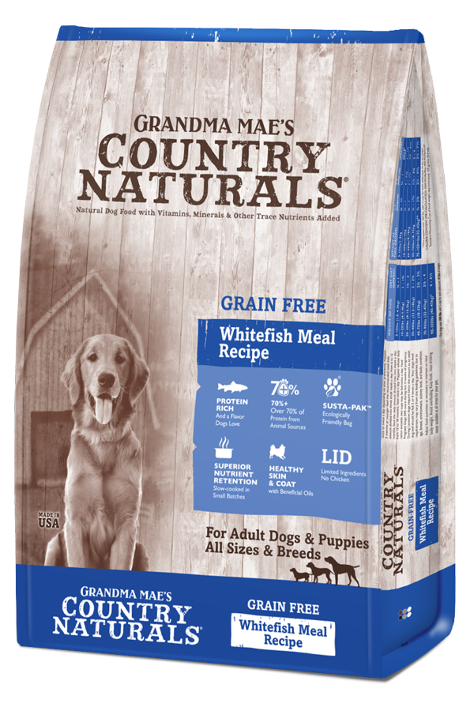
Grain Free Non- GMO Whitefish for Dogs
Healthy fish proteins from
Whitefish-Limited Ingredients
Nutritious fruits and vegetables, carrots, spinach and kelp
Contains NO chicken or poultry and no potatoes for lower glycemic index
Contains NO chicken or poultry and no potatoes for lower glycemic index
Available in: 4lb, 14lb and 25lb bags
(1.8 kg, 6.35 kg, and 11.34 kg)

Slide 31
Grain Free Non- GMO Whitefish Ingredients
Whitefish Meal, Lentils, Field Peas, Chickpeas, Canola Oil (Preserved with Mixed Tocopherols), Tapioca, Salmon Meal, Natural Flavor, Suncured Alfalfa Meal, Dried Carrots, Dried Kelp, Dried Spinach, DL-Methionine, L-Lysine, Chelated Choline Chloride, Chelated Calcium Carbonate, Chelated Monosodium Phosphate, Yucca Schidigera Extract, Dried Lactobacillus Acidophilus Fermentation Product*, Dried Bacillus Subtilis Fermentation Product*, Dried Bifidobacterium Thermophilum Fermentation Product*, Dried Bifidobacterium Longum Fermentation Product*, Dried Enterococcus Faecium Fermentation Product*, Zinc Proteinate, Vitamin E Supplement, Niacin, Zinc Sulfate, Ferrous Sulfate, Riboflavin, Copper Proteinate, Manganese Proteinate, Vitamin A Supplement, Copper Sulfate, d-Calcium Pantothenate, Vitamin B12 Supplement, Manganese Sulfate, Biotin, Vitamin D3 Supplement, Cobalt Proteinate, Thiamine Mononitrate, Folic Acid, Sodium Selenite, Calcium Iodate.
Total Microorganisms* 3.5x10⁵ CFU/lb MIN
Guaranteed Analysis
Crude Protein: 26% min. Crude Fat: 14% min. Crude Fiber: 4% max.
3540 Kcal/kg ME
440 KCAL/CUP

Slide 32
Grain Free Non-GMO Lamb
All Life Stages, Sizes & Breeds
Non-GMO Single Protein
Beneficial Oils & Flaxseed Meal
for Healthy Skin & Coat
Fresh Lamb and Lamb Meal are the first two ingredients
Available in: 4 lb, 14 lb and 25 lb bags
(1.8 kg, 6.35 kg, 11.34 kg)

Slide 33
Grain Free Non-GMO Lamb Ingredients
Lamb, Lamb Meal, Peas, Lentils, Chickpeas, Canola Oil, Pea Protein, Tapioca, Flaxseed Meal, Suncured Alfalfa Meal, Menhaden Fish Oil, Dried Kelp, Carrots, Parsley, Lettuce, Watercress, Spinach, Celery, DL-Methionine, Choline Chloride, Calcium Carbonate, Monosodium Phosphate, Dried Lactobacillus acidophilus Fermentation Product, Dried Bacillus subtilis Fermentation Product, Dried Bifidobacterium thermophilum Fermentation Product, Dried Bifidobacterium longum Fermentation Product, Dried Enterococcus faecium Fermentation Product, Zinc Proteinate, Vitamin E Supplement, Niacin, Zinc Sulfate, Ferrous Sulfate, Riboflavin, Copper Proteinate, Manganese Proteinate, Vitamin A Supplement, Copper Sulfate, d-Calcium Pantothenate, Vitamin B12 Supplement, Manganese Sulfate, Biotin, Vitamin D3 Supplement, Cobalt Proteinate, Thiamine Mononitrate, Folic Acid, Sodium Selenite, Calcium Iodate.
Total Microorganisms* 3.5x10⁵ CFU/lb MIN
Guaranteed Analysis
Crude Protein: 24% min. Crude Fat: 12% min. Crude Fiber: 4.5% max.
3260 KCAL/KG ME
405 KCAL/CUP

Slide 34
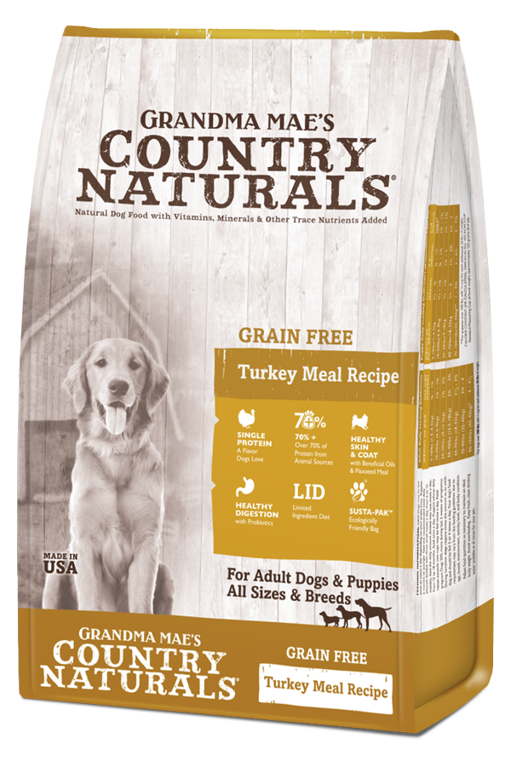
Grain Free Non-GMO Turkey
For all life stages, sizes and breeds
Non-GMO Single Protein
High quality turkey meal is the first ingredient
An economical rotation from Chicken
Available in: 4 lb, 14 lb and 25 lb bags
(1.8 kg, 6.35 kg, 11.34 kg)

Slide 35
Grain Free Non-GMO Turkey Ingredients
Turkey Meal, Lentils, Chickpeas, Field Peas, Canola Oil (preserved with mixed tocopherols), Flaxseed Meal, Sweet Potato, Tapioca, Suncured Alfalfa Meal, Menhaden Fish Oil, Dried Kelp, Dried Carrots, Dried Spinach, DL-Methionine, Choline Chloride, Calcium Carbonate, Monosodium Phosphate, Dried Lactobacillus acidophilus Fermentation Product, Dried Bacillus subtilis Fermentation Product, Dried Bifidobacterium thermophilum Fermentation Product, Dried Bifidobacterium longum Fermentation Product, Dried Enterococcus faecium Fermentation Product, Zinc Proteinate, Vitamin E Supplement, Niacin, Zinc Sulfate, Ferrous Sulfate, Riboflavin, Copper Proteinate, Manganese Proteinate, Vitamin A Supplement, Copper Sulfate, d-Calcium Pantothenate, Vitamin B12 Supplement, Manganese Sulfate, Biotin, Vitamin D3 Supplement, Cobalt Proteinate, Thiamine Mononitrate, Folic Acid, Sodium Selenite, Calcium Iodate.
Total Microorganisms* 3.5x10⁵ CFU/lb MIN
Guaranteed Analysis
Crude Protein: 24% min. Crude Fat: 12% min. Crude Fiber: 4% max.
3400 KCAL/KG ME
425 KCAL/CUP

Slide 36
Grain Free Non-GMO Chicken & Chicken Meal
All life stages, sizes,
and breeds
Non-GMO Single Protein
Fresh chicken is the first ingredient!
Chicken, Peas & Lentils 32/16
Available in: 4lb, 14lb and 25lb bags
(1.8 kg, 6.35 kg, 11.34 kg)

Slide 37
Grain Free Non-GMO Chicken Ingredients
Chicken, Chicken Meal, Peas, Lentils, Chickpeas, Chicken Fat (Preserved with Mixed Tocopherols), Flaxseed, Dried Kelp, Carrots, Menhaden Fish Oil, Spinach, Watercress, Parsley, Celery, Suncured Alfalfa Meal, DL-Methionine, Monosodium Phosphate, Choline Chloride, L-Lysine, Calcium Carbonate, Vitamin E Supplement, Dried Lactobacillus acidophilus Fermentation Product, Dried Bacillus subtilis Fermentation Product, Dried Bifidobacterium thermophilum Fermentation Product, Dried Bifidobacterium longum Fermentation Product, Dried Enterococcus faecium Fermentation Product, Niacin, d-Calcium Pantothenate, Riboflavin, Biotin, Vitamin B12 Supplement, Thiamine Mononitrate, Vitamin A Supplement, Pyridoxine Hydrochloride, Vitamin D3 Supplement, Folic Acid, Potassium Chloride, Ferrous Sulfate, Zinc Sulfate, Zinc Proteinate, Iron Proteinate, Copper Sulfate, Zinc Oxide, Manganese Proteinate, Copper Proteinate, Sodium Selenite, Calcium Iodate.
Total Microorganisms* 3.5x10⁵ CFU/lb MIN
Guaranteed Analysis
Crude Protein: 32% min. Crude Fat: 16% min
Crude Fiber: 3.5% max.
3790 KCAL/KG ME
470 KCAL/CUP

Slide 38
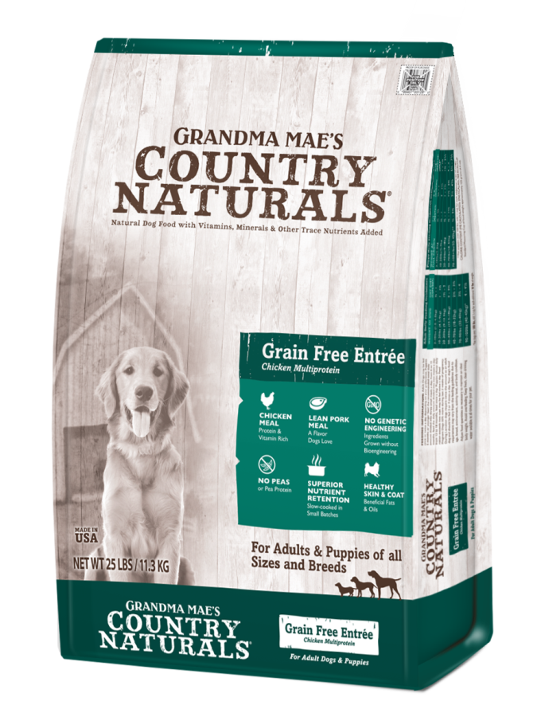
Grain Free Non-GMO Chicken Multiprotein Formula
All life stages, sizes,
and breeds
Chicken, Peas & Lentils, all
excellent sources of energy and protein
No potatoes or “pea starch” for lower glycemic index
Available in: 4lb, 14lb and 25lb bags
(1.8 kg, 6.35 kg, 11.34 kg)

Slide 39
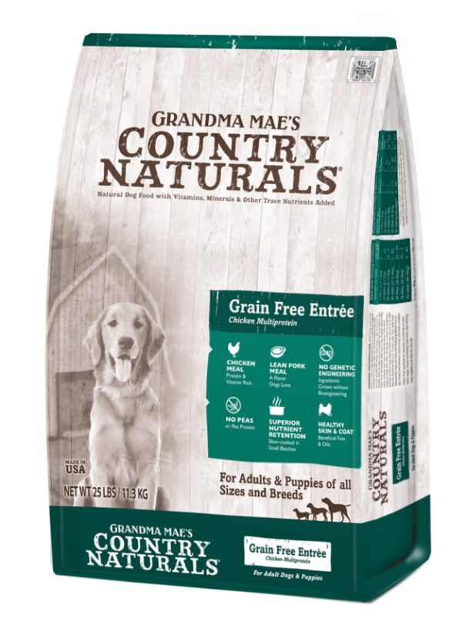
Grain Free Non-GMO Chicken Multiprotein
Ingredients
Chicken Meal, Lentils, Chickpeas, Fava Beans, Pork Meal, Chicken Fat (Preserved with Mixed Tocopherols), Whitefish Meal, Tapioca, Flaxseed Meal, Potato Protein, Suncured Alfalfa Meal, Natural Chicken Liver Flavor, Dried Kelp, Menhaden Fish Oil, Dried Carrots, Dried Spinach, Pumpkin Meal, Cranberries, Blueberries, DL-Methionine, Monosodium Phosphate, Choline Chloride, L-Lysine, Chelated Calcium Carbonate, Vitamin E Supplement, Dried Lactobacillus acidophilus Fermentation Product*, Dried Bacillus subtilis Fermentation Product*, Dried Bifidobacterium thermophilum Fermentation Product*, Dried Bifidobacterium longum Fermentation Product*, Dried Enterococcus faecium Fermentation Product*, Niacin, d-Calcium Pantothenate, Riboflavin, Biotin, Vitamin B12 Supplement, Thiamine Mononitrate, Vitamin A Supplement, Pyridoxine Hydrochloride, Vitamin D3 Supplement, Folic Acid, Chelated Potassium Chloride, Chelated Ferrous Sulfate, Zinc Sulfate, Zinc Proteinate, Iron Proteinate, Chelated Copper Sulfate, Zinc Oxide, Manganese Proteinate, Copper Proteinate, Chelated Sodium Selenite, Chelated Calcium Iodate.
Total Microorganisms* 3.5x10⁵ CFU/lb MIN
Guaranteed Analysis
Crude Protein: 30% min. Crude Fat: 15% min. Crude Fiber: 4% max.
3740 KCAL/KG ME
460 KCAL/CUP

Slide 40
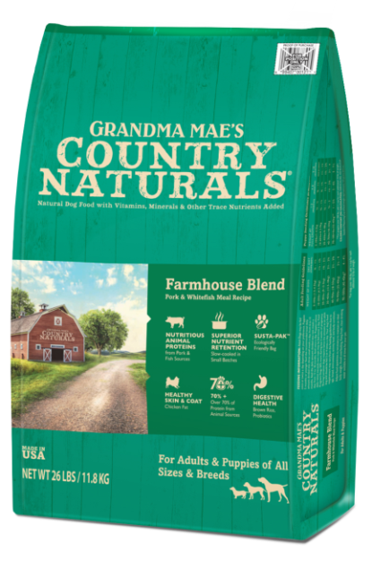
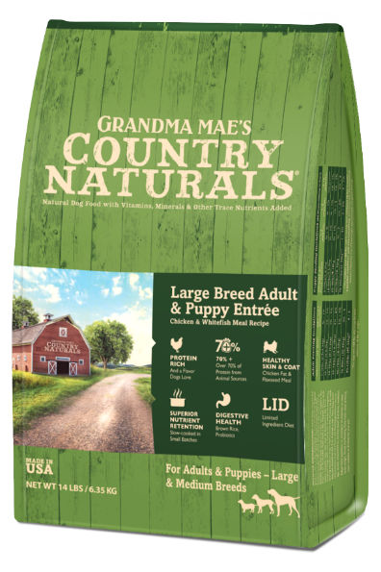
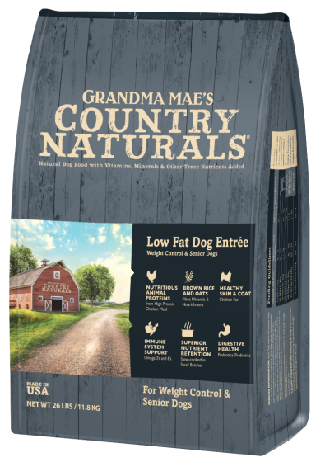
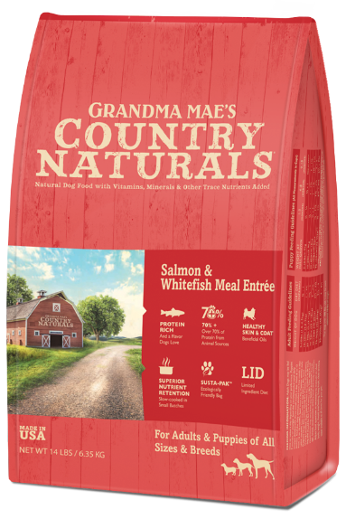
Formulas with Brown Rice
Hundreds of positive testimonials over the past 10 years
Great for picky eaters and sensitive stomachs
Adult, Puppy, Large Breed, Low Fat and Farmhouse Blend formulas

Slide 41
Adult Dog Formula: Sensitive Stomach
Chicken Meal and Whitefish
Now labeled “sensitive stomach” – contains brown rice and oatmeal.
Hundreds of testimonials received over 10 years, solving digestive issues like diarrhea, IBS & not keeping food down
Excellent for picky eaters
Available in: 4 lb, 14 lb and 26 lb bags
(1.8 kg, 6.35 kg, 11.8 kg)

Slide 42
Adult Sensitive Stomach Formula Ingredients
Chicken Meal, Brown Rice, Millet, Oats, Chicken Fat, Barley, Dried Pain Beet Pulp, Menhaden Fish Meal, Dried Egg Product, Flaxseed Meal, Natural Chicken Liver Flavor, Cranberries, Blueberries, DL-Methionine, Sweet Potatoes, Dried Apple Pomace, Dried Carrots, Dried Spinach, Potassium Chloride, Lecithin, Dicalcium Phosphate, Choline Chloride, L-Lysine, Monosodium Phosphate, Dried Lactobacillus acidophilus Fermentation Product, Dried Bacillus subtilis Fermentation Product, Dried Bifidobacterum thermophilum Fermentation Product, Dried Bifidobacterium Longum Fermentation Product*, Dried Enterococcus faecium Fermentation Product*, Zinc Proteinate, Vitamin E Supplement, Niacin, Zinc Sulfate, Ferrous Sulfate, Riboflavin, Copper Proteinate, Manganese Proteinate, Vitamin A Supplement, Copper Sulfate, d-Calcium Pantothenate, Vitamin B12 Supplement, Manganese Sulfate, Biotin, Vitamin D3 Supplement, Cobalt Proteinate, Thiamine Mononitrate, Folic Acid, Sodium Selenite, Calcium Iodate.
Total Microorganisms* 3.5x10⁵ CFU/lb MIN
Guaranteed Analysis
Crude Protein: 24% min. Crude Fat: 14% min. Crude Fiber: 4.5% max.
3680 Kcal/kg ME
460 KCAL/CUP

Slide 43
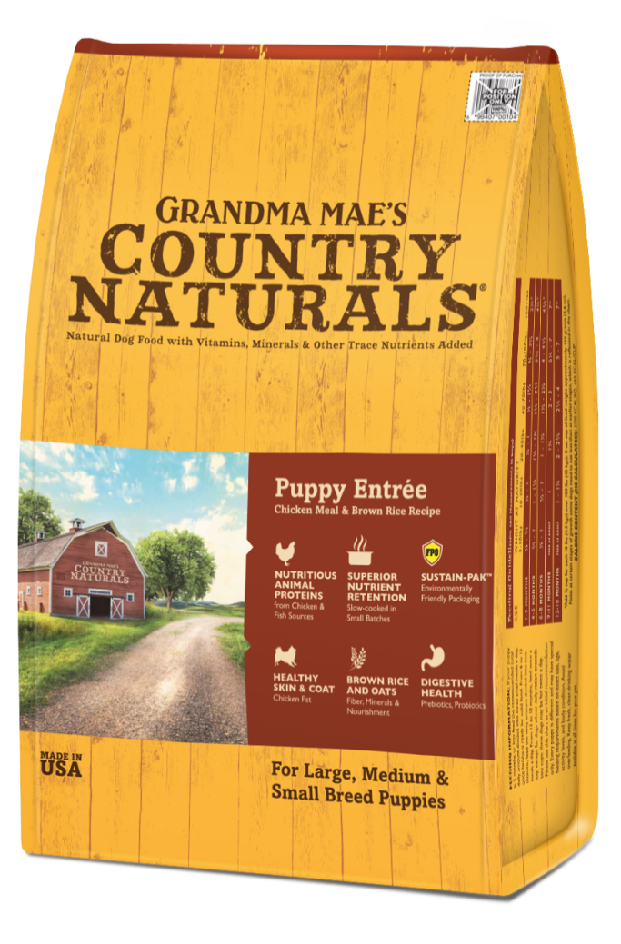
Puppy Formula
Chicken and Whitefish
For all sizes and breeds
Formulated for optimal health, firm stools, and good temperament
No better tasting puppy food in the world!
Available in: 4 lb, 14 lb and 26 lb bags
(1.8 kg, 6.35 kg, 11.8 kg)

Slide 44
Puppy Formula Ingredients
Chicken Meal, Brown Rice, Millet, Oats, Chicken Fat (preserved with Mixed Tocopherols), Barley, Dried Plain Beet Pulp, Menhaden Fish Meal, Dried Eggs, Flaxseed Meal, Natural Chicken Liver Flavor, Potassium Chloride, Cranberries, Blueberries, DL-Methionine, Sweet Potato, Choline Chloride, Dried Apple Pomace, Dried Carrots, Sodium Chloride, Lecithin, L-Lysine, Dicalcium Phosphate, Monosodium Phosphate, Dried Lactobacillus acidophilus Fermentation Product*, Dried Bacillus subtilis Fermentation Product*, Dried Bifidobacterium thermophilum Fermentation Product*, Dried Bifidobacterium longum Fermentation Product*, Dried Enterococcus faecium Fermentation Product*, Zinc Proteinate, Vitamin E Supplement, Niacin, Zinc Sulfate, Chelated Ferrous Sulfate, Riboflavin, Copper Proteinate, Manganese Proteinate, Vitamin A Supplement, Chelated Copper Sulfate, d-Calcium Pantothenate, Vitamin B12 Supplement, Chelated Manganese Sulfate, Biotin, Vitamin D3 Supplement, Cobalt Proteinate, Thiamine Mononitrate, Folic Acid, Chelated Sodium Selenite, Chelated Calcium Iodate.
Total Microorganisms* 3.5x10⁵ CFU/lb MIN
Guaranteed Analysis
Crude Protein: 26% min. Crude Fat: 14% min. Crude Fiber: 4.5% max.
3700 KCAL/KG ME
465 KCAL/CUP

Slide 45
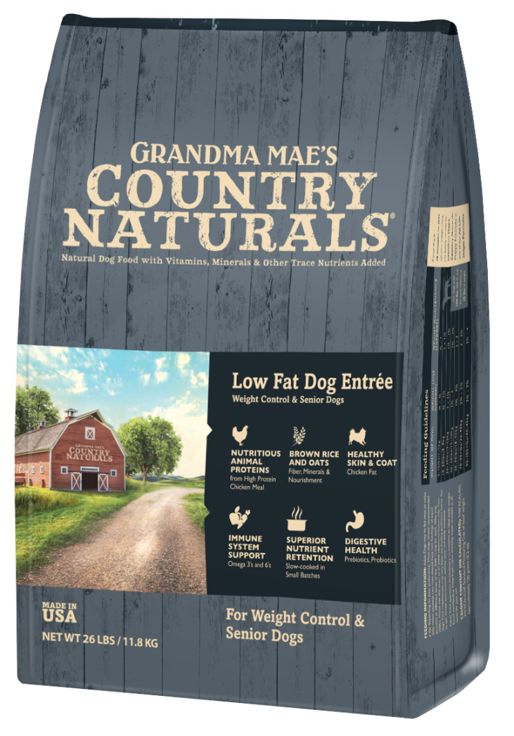
Low Fat & Senior
Chicken & Brown Rice
Optimal protein, fat, and fiber for senior dogs
700 mg/kg Glucosamine, 500 mg/kg Chondroitin, it’s “jointastic” – made to promote healthy joints, especially important in senior dogs
Lower in calories and fat for weight control or loss for any dog
Also for low activity dogs
Available in: 4lb, 14lb and 26lb bags
(1.8 kg, 6.35 kg, 11.8 kg)

Slide 46
Low Fat & Senior Ingredients
Chicken Meal, Brown Rice, Oats, Sweet Potato, Beet Pulp, Millet, Chicken Fat, Natural Chicken Liver Flavor, Barley, Dried Egg, Flaxseed Meal, Suncured Alfalfa Meal, Peas, Cranberries, Blueberries, DL-Methionine,
Dried Carrots, Dried Spinach, Apple Pomace, Sodium Chloride, Tomato Pomace, Chelated Potassium Chloride, Lecithin, Dicalcium Phosphate, Chelated Choline Chloride, L-Lysine, Monosodium Phosphate, Glucosomine Hydrochloride, Chondroitin Sulfate, Dried Lactobacillus acidophilus Fermentation Product*, Dried Bacillus subtilis Fermentation Product*, Dried Bifidobacterium thermophilum Fermentation Product , Dried Bifidobacterium longum Fermentation Product*, Dried Enterococcus faecium Fermentation Product*, Yucca Schidigera Extract, Zinc Proteinate, Vitamin E Supplement, Niacin, Zinc Sulfate, Chelate Ferrous Sulfate, Riboflavin, Chelated Copper Proteinate, Chelated Manganese Proteinate, Vitamin A Supplement, Chelated Copper Sulfate, d-Calcium Pantothenate, Vitamin B12 Supplement, Chelated Manganese Sulfate, Biotin, Vitamin D3 Supplement, Chelated Cobalt Proteinate, Thiamine Mononitrate, Folic Acid, Chelated Sodium Selenite, Chelated Calcium Iodate.
Total Microorganisms* 3.5x10⁵ CFU/lb MIN
Guaranteed Analysis
Crude Protein: 23% min. Crude Fat: 7% min. 9% max. Crude Fiber: 5.5% max.
3010 Kcal/kg ME
370 KCAL/CUP

Slide 47
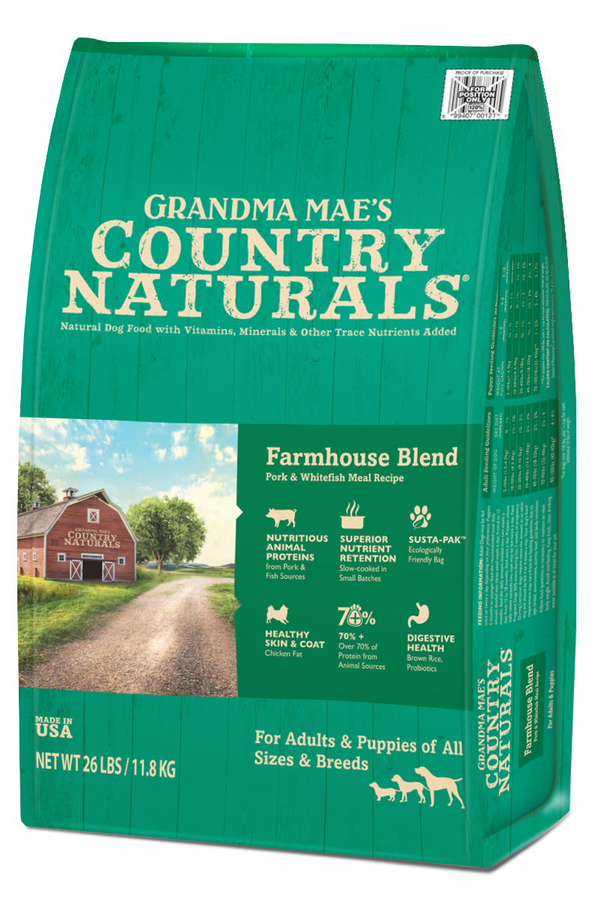
Farmhouse Blend
All life stages, sizes, and breeds
Pork & Whitefish
No chicken, lamb or beef for allergy avoidance and protein rotation
Our high quality pork is a great, healthy protein choice for dogs and a great value!
Available in: 4lb, 14lb and 26lb bags
(1.8 kg, 6.35 kg, 11.8 kg)

Slide 48
Farmhouse Blend Ingredients
Pork Meal, Oats, Brown Rice, Pearled Barley, Whitefish Meal, Canola Oil (preserved with Mixed Tocopherols), Dried Eggs, Field Peas, Potassium Chloride, Cranberries, Blueberries, D-Methionine, Choline Chloride, Salt, Sweet Potato, Dried Apple Pomace, Dried Spinach, Lecithin, L-Lysine, Dicalcium Phosphate, Monosodium Phosphate, Yucca Schidigera Extract, Dried Lactobacillus acidophilus Fermentation Product*, Dried Bacillus subtilis Fermentation Product, Dried Bifidobacterium Thermophilum Fermentation Product, Dried Bifidobacterium longum Fermentation Product, Dried Enterococcus faecium Fermentation Product, Zinc Proteinate, Vitamin E Supplement, Niacin, Zinc Sulfate, Ferrous Sulfate, Riboflavin, Copper Proteinate, Manganese Proteinate, Vitamin A Supplement, Copper Sulfate, d-Calcium Pantothenate, Vitamin B12 Supplement, Manganese Sulfate, Biotin, Vitamin D3 Supplement, Cobalt Proteinate, Thiamine Mononitrate, Folic Acid, Sodium Selenite, Calcium Iodate.
Total Microorganisms* 3.5x10⁵ CFU/lb MIN
Guaranteed Analysis
Crude Protein: 24% min. Crude Fat: 12% min. Crude Fiber: 3.5% max.
3310 KCAL/KG ME
410 KCAL/CUP

Slide 49
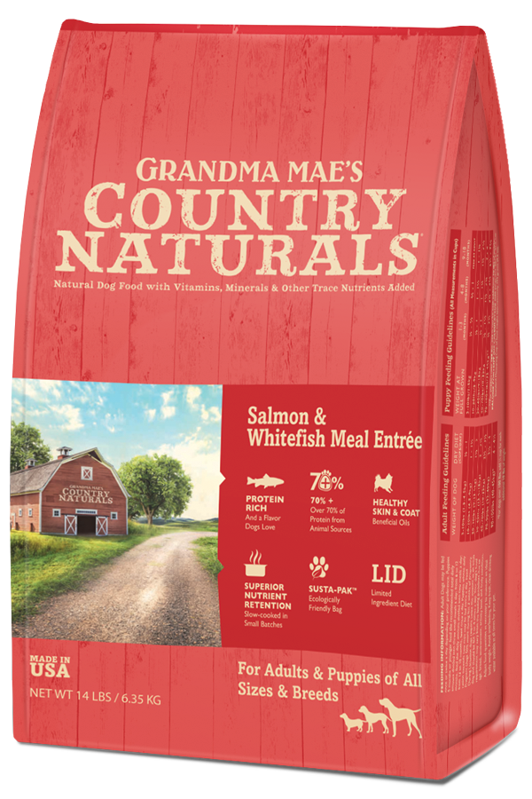
Salmon & Whitefish Meal Entrée
All life stages, sizes, and breeds
LID: no chicken or beef for allergy avoidance and protein rotation
Brown Rice & Oats for Sensitive Stomachs
Our high quality salmon is a great, healthy protein choice for dogs and a flavor they love!
Available in: 4lb, 14lb and 25lb bags
(1.8 kg, 6.35 kg, 11.34 kg)

Slide 50
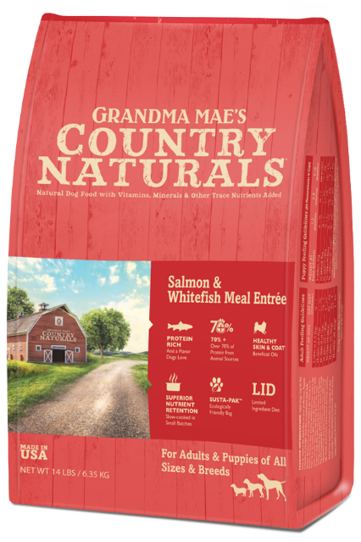
Salmon & Whitefish Meal Entrée Ingredients
Salmon Meal, Brown Rice, Whitefish Meal, Oats, Pearled Barley, Millet, Canola Oil (preserved with Mixed Tocopherols), Dried Spinach, Dried Carrots, Natural Flavor, Miscanthus Grass, Dicalcium Phosphate, Monosodium Phosphate, Salt, Potassium Chloride, DL-Methionine, Choline Chloride, L-Lysine, Dried Lactobacillus acidophilus Fermentation Product, Dried Bacillus subtilis Fermentation Product, Dried Bifidobacterium thermophilum Fermentation Product, Dried Bifidobacterium longum Fermentation Product, Dried Enterococcus faecium Fermentation Product, Zinc Proteinate, Vitamin E Supplement, Niacin, Zinc Sulfate, Ferrous Sulfate, Riboflavin, Copper Proteinate, Manganese Proteinate, Vitamin A Supplement, Copper Sulfate, d-Calcium Pantothenate, Vitamin B12 Supplement, Manganese Sulfate, , Biotin, Vitamin D3 Supplement, Cobalt Proteinate, Thiamine Mononitrate, Folic Acid, Sodium Selenite, Calcium Iodate.
Total Microorganisms* 3.5x10⁵ CFU/lb MIN
Guaranteed Analysis
Crude Protein: 24% min. Crude Fat: 14% min. Crude Fiber: 4% max.
3600 KCAL/KG ME
445 KCAL/CUP

Slide 51
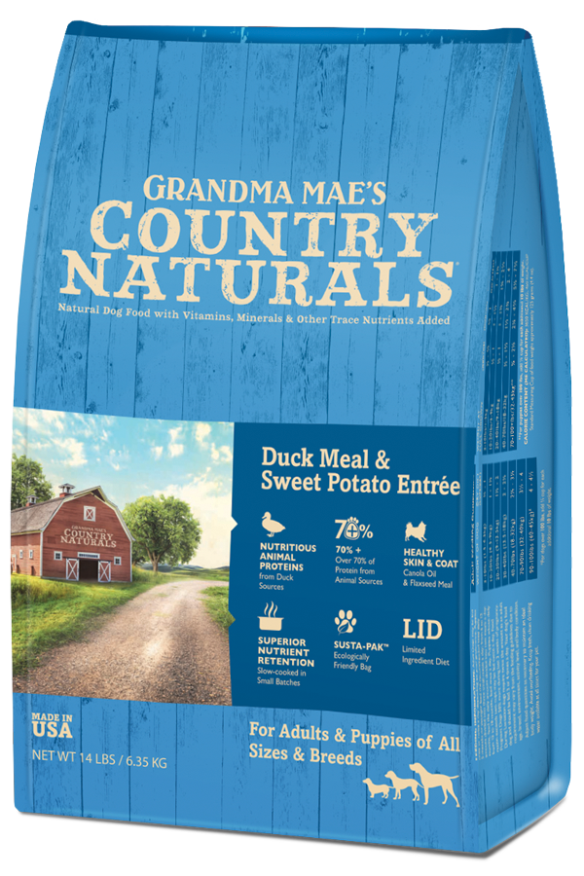
Duck Meal & Sweet Potato Entrée
All life stages, sizes, and breeds
Similar but better quality than
One of the US’s Most Popular Formulas
LID: no chicken or beef for allergy avoidance and protein rotation
Available in: 4lb, 14lb and 25lb bags
(1.8kg, 6.35 kg, 11 kg)

Slide 52
Duck Meal & Sweet Potato Entrée Ingredients
Duck Meal, Brown Rice, Oats, Pearled Barley, Millet, Canola Oil (preserved with Mixed Tocopherols), Sweet Potatoes, Pea Protein, Menhaden Meal, Natural Flavor, Flaxseed, Dried Spinach, Dried Carrots, Miscanthus Grass, Dicalcium Phosphate, DL-Methionine, Monosodium Phosphate, Salt, Potassium Chloride, Choline Chloride, L-Lysine, Dried Lactobacillus acidophilus Fermentation Product, Dried Bacillus subtilis Fermentation Product, Dried Bifidobacterium thermophilum Fermentation Product, Dried Bifidobacterium longum Fermentation Product, Dried Enterococcus faecium Fermentation Product, Zinc Proteinate, Vitamin E Supplement, Niacin, Zinc Sulfate, Ferrous Sulfate, Riboflavin, Copper Proteinate, Manganese Proteinate, Vitamin A Supplement, Copper Sulfate, d-Calcium Pantothenate, Vitamin B12 Supplement, Manganese Sulfate, , Biotin, Vitamin D3 Supplement, Cobalt Proteinate, Thiamine Mononitrate, Folic Acid, Sodium Selenite, Calcium Iodate.
Total Microorganisms* 3.5x10⁵ CFU/lb MIN
Guaranteed Analysis
Crude Protein: 24% min. Crude Fat: 14% min. Crude Fiber: 4% max.
3650 KCAL/KG ME
450 KCAL/CUP

Slide 53
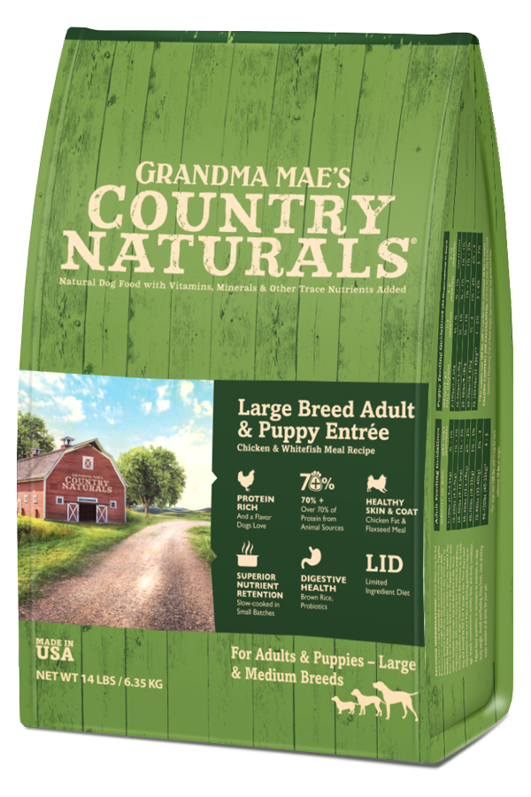
Large Breed Formula
For Large Dogs of all life stages and breeds over 80 pounds as adults, and for puppies up to 2 years
Protein, fat and calcium levels adjusted for optimal large breed health
With 800 mg/kg Glucosamine and 600 mg/kg Chondroitin, it’s “jointastic” – made to promote healthy joints, especially important in large breeds
Available in: 28lb and 35lb bags
(12.7 kg and 15.9 kg)

Slide 54
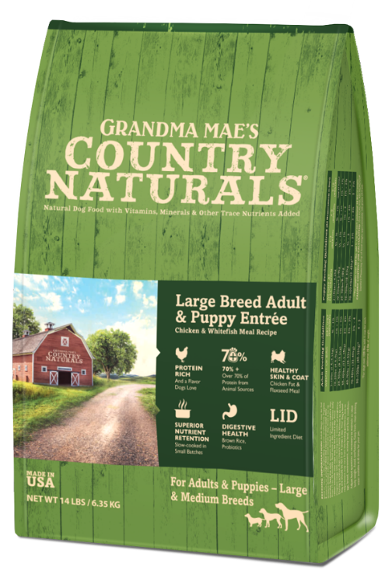
Large Breed Formula Ingredients
Chicken Meal, Brown Rice, Oats, Chicken Fat, Barley, Whitefish Meal, Ground Flaxseed, Eggs, Dried Beet Pulp, Cranberries, Blueberries, DL-Methionine, Sweet Potatoes, Apples, Carrots, Watercress, Spinach, Inulin (from Chicory), L-Lysine, Glucosamine Hydrochloride, Chondroitin Sulfate, Dried Kelp, Yucca Schidigera Extract, Herring Oil, Chelated Potassium Chloride, Chelated Dicalcium Phosphate, Vitamin E Supplement, Dried Lactobacillus acidophilus Fermentation Product*, Dried Bacillus subtilis Fermentation Product*, Dried Bifidobacterium thermophilum Fermentation Product*, Dried Bifidobacterium Longum Fermentation Product*, Dried Enterococcus faecium Fermentation Product*, Chelated Calcium Carbonate, Chelated Choline Chloride, Chelated Zinc Sulfate, Vitamin A Supplement, Vitamin D3 Supplement, Chelated Ferrous Sulfate, Chelated Copper Sulfate, Chelated Manganese Sulfate, Niacin, Chelated Calcium Pantothenate, Vitamin B-12 Supplement, Folic Acid, Riboflavin, Sodium Selenite, Pyridoxine Hydrochloride, Chelated Calcium Iodate, Thiamine Mononitrate, Biotin, Chelated Cobalt Sulfate, Rosemary Extract.
Total Microorganisms* 3.5x10⁵ CFU/lb MIN
Guaranteed Analysis
Crude Protein: 25% min. Crude Fat: 12% min. Crude Fiber: 4% max.
3510 Kcal/kg ME
430 KCAL/CUP

Slide 55
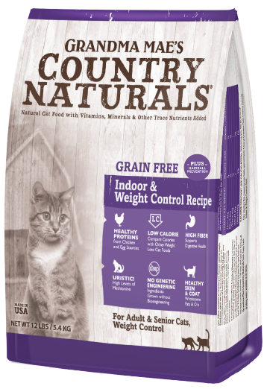
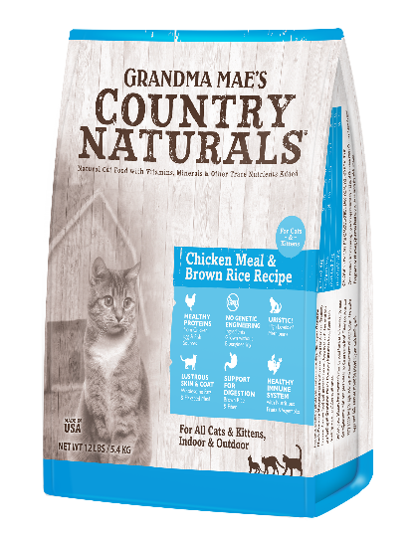
Formulas for Cats
All our cat foods, both kibble and canned formulas, are “Uristic”
This means they contain 1% Methionine
We supplement the level that naturally occurs in meat
Methionine is an amino acid known to prevent urine crystals, prevent inflammation, and control ammonia.
This will help prevent development of urinary tract problems

Slide 56
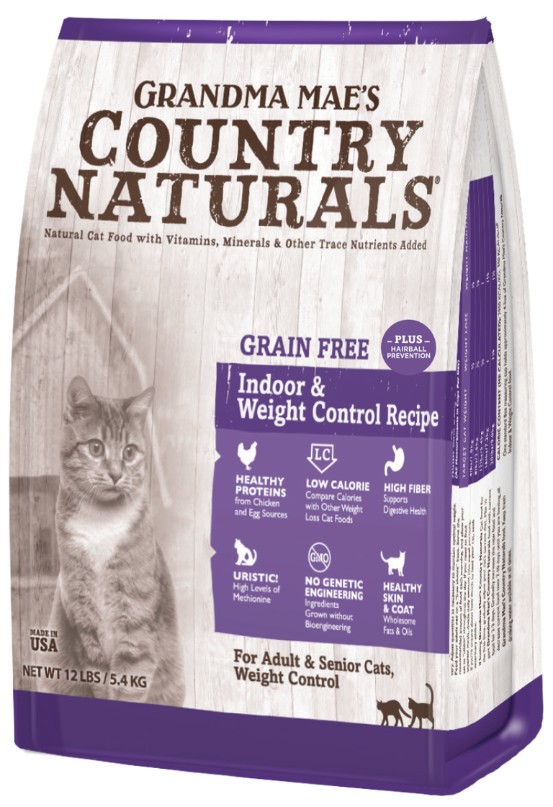
Grain Free Non-GMO Weight Control/Hairball Recipe
Formulated especially for adult, senior and less active cats
Both low fat AND low calorie – under 350 calories per cup
7% fiber for optimal hairball prevention – also good for weight loss and seniors to prevent constipation
Separate Feeding charts for weight loss and weight maintenance
Uristic – just like all our other formulas for cats
Available in: 4lb and 12lb bags
(1.8 kg and 5.4 kg)

Slide 57
Grain Free Non-GMO Weight Control/Hairball Recipe
Ingredients
Chicken Meal, Yellow Peas, Lentils, Pea Flour, Sweet Potato, Chicken Fat (preserved with Mixed Tocopherols), Dried Egg, Whitefish Meal, Pea Protein, Tapioca, Natural Chicken Liver Flavor, Brewers Dried Yeast, Powdered Cellulose, Dried Tomato Pomace, Lecithin, DL-Methionine, Calcium Carbonate, L-Lysine, Salt, Taurine, Yucca Schidigera Extract, Vitamin E Supplement, Niacin Supplement, Thiamine Mononitrate, Pyridoxine Hydrochloride, Riboflavin Supplement, Ascorbic Acid, Biotin, d-Calcium Pantothenate, Vitamin B12 Supplement, Vitamin A Acetate, Vitamin D3 Supplement, Folic Acid, Potassium Chloride, Ferrous Sulfate, Zinc Sulfate, Zinc Proteinate, Iron Proteinate, Copper Sulfate, Zinc Oxide, Manganese Sulfate, Manganese Proteinate, Copper Proteinate, Manganous Oxide, Sodium
Selenite, Calcium Iodate.
Total Microorganisms* 3.5x10⁵ CFU/lb MIN
Guaranteed Analysis
Crude Protein: 30% min. Crude Fat: 8% min 10% max Crude Fiber: 7.0% max.
2950 KCAL/KG ME
350 KCAL/CUP

Slide 58
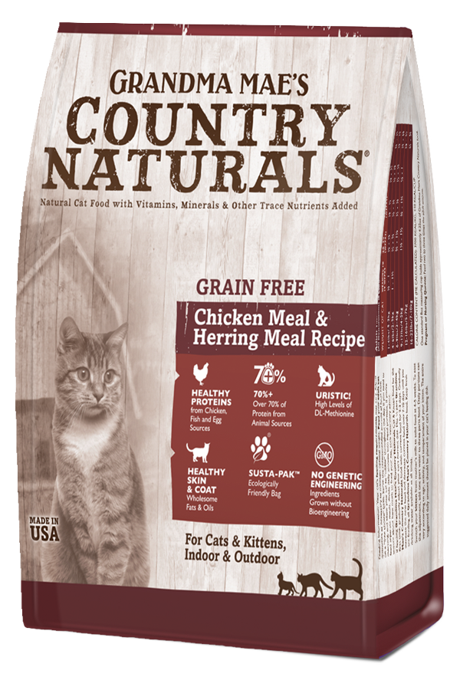
Grain Free Non-GMO formula for Cats and Kittens
Chicken Meal, Herring Meal & Egg
With high levels of DL-Methionine for urinary tract health
Three healthy animal proteins from chicken, fish, and egg sources
No potatoes or “pea starch” for lower glycemic index
Available in: 3lb, 6lb and 12lb bags
(1.4 kg, 2.7 kg, and 5.4 kg)

Slide 59
Grain Free Non-GMO formula for Cats and Kittens Ingredients
Chicken Meal, Peas, Lentils, Chickpeas, Chicken Fat, Herring Meal, Egg, Menhaden Fish Oil, DL-Methionine, Chelated Calcium Carbonate, Lecithin, Chelated Choline Chloride, L-Lysine, Taurine, Yucca Schidigera Extract, Vitamin E Supplement, Niacin Supplement, Organic Dried Kelp, Thiamine Mononitrate, Pyridoxine Hydrochloride, Riboflavin Supplement, Ascorbic Acid, Biotin, d-Calcium Pantothenate, Vitamin B12 Supplement, Vitamin A Acetate, Vitamin D3 Supplement, Citric Acid, Folic Acid, Chelated Potassium Chloride, Iron Sulfate, Zinc Sulfate, Chelated Zinc Proteinate, Chelated Iron Proteinate, Copper Sulfate, Zinc Oxide, Manganese Sulfate, Chelated Manganese Proteinate, Chelated Copper Proteinate, Manganous Oxide, Sodium Selenite, Chelated Calcium Iodate.
Total Microorganisms* 3.5x10⁵ CFU/lb MIN
Guaranteed Analysis
Crude Protein: 35% min. Crude Fat: 17% min. Crude Fiber: 3.5% max.
3700 KCAL/KG ME
440 KCAL/CUP

Slide 60
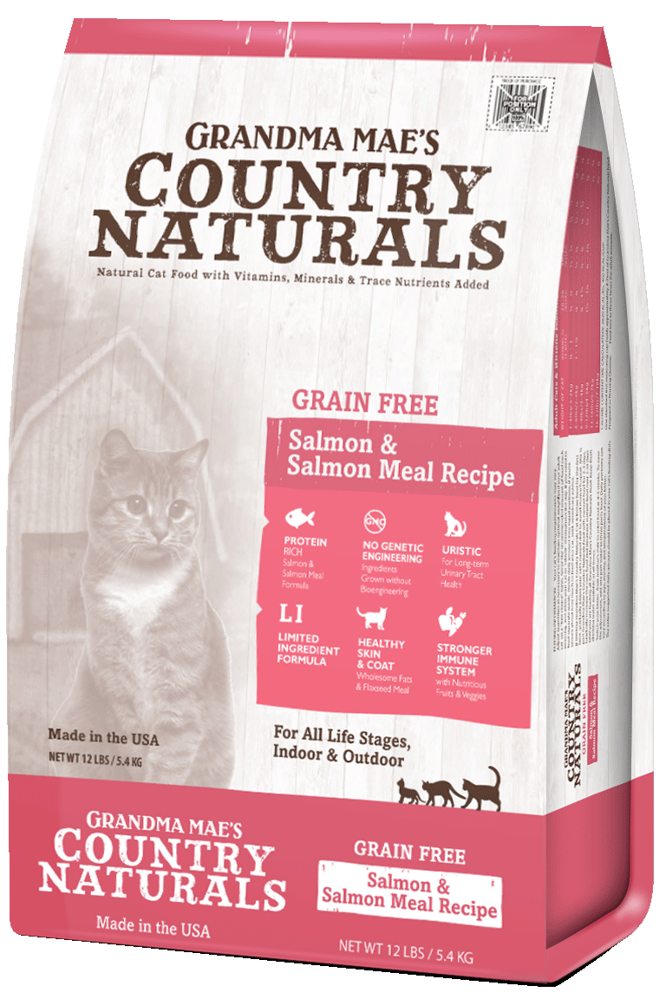
Grain Free Non-GMO Salmon for Cats and Kittens
For Cats & Kittens of all ages, sizes, & breeds
Indoor & Outdoor
Non-GMO Limited Ingredients
Salmon, Salmon Meal & Peas 33/20
Low in Magnesium & Ash
Available in: 3lb, 6 lb and 12 lb bags
(1.4 kg, 2.7 kg, and 5.4 kg)

Slide 61
Grain Free Non-GMO Salmon for Cats and Kittens Ingredients
Salmon Meal, Field Peas, Chicken Fat (preserved with Mixed Tocopherols), Garbanzo Beans, Herring Meal, Tapioca, Dried Egg, Lentils, Pea Protein, Flaxseed Meal, DL-Methionine, Choline Chloride, Taurine, Cranberries, Blueberries, L-Lysine, Calcium Carbonate, Monosodium Phosphate, Vitamin E Supplement, Dried Lactobacillus acidophilus Fermentation Product, Dried Bacillus subtilis Fermentation Product, Dried Bifidobacterium thermophilum Fermentation Product, Dried Bifidobacterium longum Fermentation Product, Dried Enterococcus faecium Fermentation Product, Chelated Zinc Proteinate, Zinc Sulfate, Selenium Yeast, Ferrous Sulfate, Chelated Copper Proteinate, Chelated Manganese Proteinate, Vitamin A Supplement, Copper Sulfate, Niacin, Calcium Pantothenate, Vitamin B12 Supplement, Manganese Sulfate, Riboflavin, Biotin, Vitamin D3 Supplement, Chelated Cobalt Proteinate, Thiamine Mononitrate, Folic Acid, Calcium Iodate.
Total Microorganisms* 3.5x10⁵ CFU/lb MIN
Guaranteed Analysis
Crude Protein: 31% min. Crude Fat: 19% min. Crude Fiber: 2.5% max.
3820 KCAL/KG ME
460 KCAL/CUP

Slide 62
Non-GMO Cat and Kitten Formula
Chicken & Brown Rice
With 1% DL-Methionine
for urinary tract health
Bag design changing to match other cat bags
Kibble shape designed especially for the way cats and kittens eat
Available in: 3lb, 6lb and 12lb bags
(1.4 kg, 2.7 kg, and 5.4 kg)

Slide 63
Non-GMO Cat and Kitten Formula Ingredients
Chicken Meal, Brown Rice, Chicken Fat (preserved with Mixed Tocopherols), Barley, Pea Protein, Eggs, Menhaden Fish Meal, Tomato Pomace, Natural Chicken Liver Flavor, Flaxseed Meal, Brewer’s Yeast, DL-Methionine, Taurine, Chelated Potassium Chloride, Chelated Choline Chloride, Cranberries, Blueberries, Sweet Potato, Apples, Carrots, Parsley, Watercress, Spinach, Celery, Lecithin, Salt, L-Lysine, Chelated Calcium Carbonate, Monosodium Phosphate, Vitamin E Supplement, Yucca Schidigera Extract, Dried Lactobacillus acidophilus Fermentation Product*, Dried Bacillus subtilis Fermentation Product*, Dried Bifidobacterium thermophilum Fermentation Product*, Dried Bifidobacterium longum Fermentation Product*, Dried Enterococcus faecium Fermentation Product*, Zinc Proteinate, Zinc Sulfate, Selenium Yeast, Ferrous Sulfate, Copper Proteinate, Manganese Proteinate, Vitamin A Supplement, Chelated Copper Sulfate, Niacin, Calcium Pantothenate, Vitamin B12 Supplement, Chelated Manganese Sulfate, Riboflavin, Biotin, Vitamin D3 Supplement, Cobalt Proteinate, Thiamine Mononitrate, Folic Acid, Chelated Calcium Iodate.
Total Microorganisms* 3.5x10⁵ CFU/lb MIN
Guaranteed Analysis
Crude Protein: 34% min. Crude Fat: 20% min. Crude Fiber: 3.5% max.
3900 Kcal/kg ME
470 KCAL/CUP

Slide 64
Using the Bag as a selling tool
Front of bags have key nutritional features clearly listed
Back of bags list bullet points with comprehensive features and benefits

Slide 65
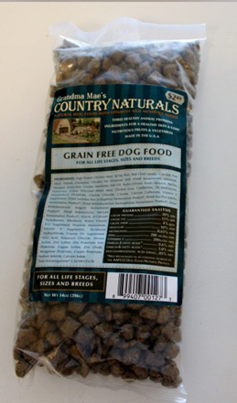
Very Large Trial Sizes
Your Best marketing tool: 9-14 oz trial sizes
These pre-priced packs are available for all formulas: Pre-priced so they are of more value!
Best given to a customer when they ask a question where they seem interested in trying something new (if you can't sell them an actual bag).
Avoid letting people take freebies without having a conversation about the food (or let them only take one)
Always make a recommendation when giving them away
“This is a great food, I recommend it!”
It’s even better to make a specific recommendation addressing that customers interests or concerns

Slide 66
Helps Military Families
If a family has an immediate member (husband or wife) serving in the military overseas, Grandma Mae’s Country Naturals will feed that family’s pets up to 25lbs/month
Must first have their application approved at countrynaturals.com
Must be able to pick up food at a participating store
The Country Naturals office will arrange with store manager to accept voucher brought in by customer

Slide 67
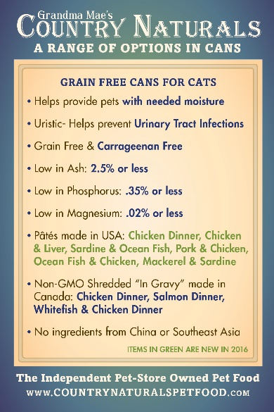
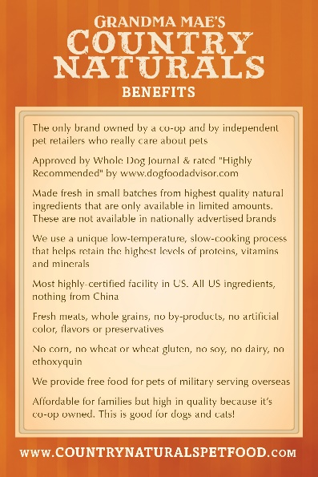
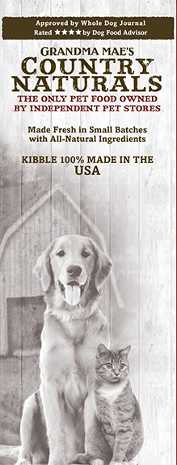
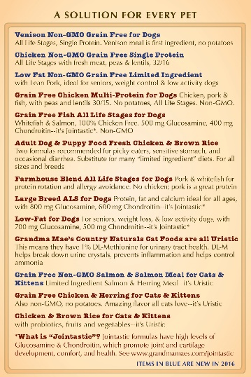
Marketing and Training Tools
Comprehensive brochures for customers
Includes all dry and canned formulas, complete ingredient listing, guaranteed analysis and testimonials
Pocket “memory cards” for you:
One side has key selling points of the brand, one side has key nutritional issues addressed by each formula of dry food

Slide 68
Grain Free Dog Treats
Six Meat Treats, Three Proteins, Four Shapes
Simple LID Natural Ingredients
BOTH a hearty snack & training treat
Made in USA

Slide 69
Grain Free 80%+ Meat Treats
Chicken Sticks:
INGREDIENTS: Chicken, Vegetable Glycerin (preserved with Mixed Tocopherols), Rosemary Extract, Natural Smoke Flavoring.
Duck Tenders:
INGREDIENTS: Duck, Turkey, Vegetable Glycerin, Mixed Tocopherols (preservative), Rosemary Extract, Natural Smoke Flavoring.
Duck Sticks:
INGREDIENTS: Duck, Turkey, Vegetable Glycerin, Mixed Tocopherols (preservative), Rosemary Extract, Natural Smoke Flavoring.

Slide 70
Grain Free 80%+ Meat Treats
Beef Bars:
INGREDIENTS: Beef, Vegetable Glycerin, Mixed
Tocopherols (preservative), Rosemary Extract.
Beef Sausages:
INGREDIENTS: Beef, Vegetable Glycerin, Mixed
Tocopherols (preservative), Rosemary Extract.
Chicken Tenders:
INGREDIENTS: Chicken, Vegetable Glycerin (preserved with Mixed Tocopherols), Rosemary Extract, Natural Smoke Flavoring.

Slide 71
Chunks in Gravy 2.8oz Cans for Cats
100% Grain Free and Carrageenan Free
Three Formulas:
Lamb Chunks Dinner
Chicken Chunks Dinner
Beef & Chicken Dinner
All our cat
foods are
Low in Ash, Phosphorus, and
Magnesium
For cats and kittens, available in 2.8 oz (79 g) cans

Slide 72
Lamb Chunks Dinner: Fish Free
Lamb Broth, Lamb, Chicken, Dried Egg Whites, Tapioca Starch, Pea Protein, Sunflower Oil, Dicalcium Phosphate, Dextrose Monohydrate, Tuna Oil, Rice Hulls, Guar Gum, Potassium Chloride, Salt, Choline Chloride, Magnesium Sulfate, Taurine, Calcium Carbonate, Caramel Color, Zinc Amino Acid Chelate, Iron Amino Acid Chelate, dl-alpha Tocopherol Acetate, Calcium L-Ascorbyl-2-Monophosphate, Thiamine Mononitrate, Nicotinic Acid, Manganese Amino Acid Chelate, Vitamin A Acetate, Copper Amino Acid Chelate, Calcium Iodate, d-Calcium Pantothenate, Sodium Selenite, Riboflavin, Vitamin B12 Supplement, Pyridoxine Hydrocholoride, Folic Acid, Cholecalciferol, Biotin, Menadione Sodium Bisulfite Complex (source of vitamin K activity).
GUARANTEED ANALYSIS:
Crude Protein = 8% min
Crude Fat = 3% min
Crude Fiber = 0.5% max
Moisture = 82% max
CALORIE CONTENT:
1041 kcal/kg (calculated). A 2.8oz (79g) can provides 83 kcal of metabolizable energy (calculated).
Grain Free

Slide 73
Chicken Chunks Dinner: Fish Free
Chicken Broth, Chicken, Dried Egg Whites, Tapioca Starch, Pea Protein, Sunflower Oil, Dicalcium Phosphate, Rice Hulls, Guar Gum, Dextrose Monohydrate, Potassium Chloride, Salt, Choline Chloride, Magnesium Sulfate, Calcium Carbonate, Tuna Oil, Taurine, Zinc Amino Acid Chelate, Iron Amino Acid Chelate, dl-alpha Tocopherol Acetate, Calcium L-Ascorbyl-2-Monophosphate, Thiamine Mononitrate, Nicotinic Acid, Manganese Amino Acid Chelate, Vitamin A Acetate, Copper Amino Acid Chelate, Calcium Iodate, d-Calcium Pantothenate, Sodium Selenite, Riboflavin, Vitamin B12 Supplement, Pyridoxine Hydrocholoride, Folic Acid, Cholecalciferol, Biotin, Menadione Sodium Bisulfite Complex (source of vitamin K activity).
GUARANTEED ANALYSIS:
Crude Protein = 8% min
Crude Fat = 3% min
Crude Fiber = 0.5% max
Moisture = 82% max
CALORIE CONTENT:
901 kcal/kg (calculated). A 2.8oz (79g) can provides 72 kcal of metabolizable energy (calculated).
Grain Free

Slide 74
Beef & Chicken Dinner: Fish Free Chunks
Beef Broth, Beef, Chicken, Dried Egg Whites, Tapioca Starch, Pea Protein, Sunflower Oil, Tuna Oil, Rice Hulls, Guar Gum, Dextrose Monohydrate, Caramel Color, Potassium Chloride, Salt, Choline Chloride, Magnesium Sulfate, Calcium Carbonate, Taurine, Zinc Amino Acid Chelate, Iron Amino Acid Chelate, dl-alpha Tocopherol Acetate, Calcium L-Ascorbyl-2-Monophosphate, Thiamine Mononitrate, Nicotinic Acid, Manganese Amino Acid Chelate, Vitamin A Acetate, Copper Amino Acid Chelate, Calcium Iodate, d-CalciumPantothenate, Sodium Selenite, Riboflavin, Vitamin B12 Supplement, Pyridoxine Hydrocholoride, Folic Acid, Cholecalciferol, Biotin, Menadione Sodium Bisulfite Complex (source of vitamin K activity).
GUARANTEED ANALYSIS:
Crude Protein = 8% min
Crude Fat = 2.5% min
Crude Fiber = 0.5% max
Moisture = 82% max
CALORIE CONTENT:
845 kcal/kg (calculated). A 2.8oz (79g) can provides 68 kcal of metabolizable energy (calculated).
Grain Free

Slide 75
Entrée Paté 2.8oz Cans for Cats
100% Grain Free and Carrageenan Free
Five Formulas:
All our cat
foods are
Tuna Entrée
Whitefish Entrée
Tuna & Chicken Entrée
Chicken Entrée
Beef Entrée
Low in Ash,
Phosphorus, and Magnesium

Slide 76
Grain Free Paté for Cats
Tuna Entrée:
Tuna Broth, Tuna, Chicken, Tapioca Starch, Pea Protein, Tricalcium Phosphate, Guar Gum, Potassium Chloride, Salt, Magnesium Sulfate, Choline Chloride, Dextrose, Taurine, Zinc Amino Acid Chelate, Iron Amino Acid Chelate, dl-alpha-Tocopherol Acetate, Thiamine Mononitrate, Manganese Amino Acid Chelate, Niacin, Vitamin A Acetate, Copper Amino Acid Chelate, Calcium Iodate, Calcium Pantothenate, Sodium Selenite, Riboflavin Supplement, Pyridoxine Hydrochloride, Vitamin B12 Supplement, Folic Acid, Biotin, Vitamin D3 Supplement, Menadione Sodium Bisulfite Complex (source of Vitamin K activity).
GUARANTEED ANALYSIS:
Crude Protein = 9% min
Crude Fat = 2% min
Crude Fiber = 1% max
Moisture = 84% max
CALORIE CONTENT:
710 kcal/kg (calculated). A 2.8oz (79g) can provides 57 kcal of metabolizable energy (calculated).
Grain Free

Slide 77
Grain Free Paté for Cats
Whitefish Entrée:
Fish Broth, Mackerel, Chicken, Tapioca Starch, Pea Protein, Tricalcium Phosphate, Guar Gum, Potassium Chloride, Salt, Magnesium Sulfate, Choline Chloride, Dextrose, Taurine, Zinc Amino Acid Chelate, Iron Amino Acid Chelate, dl-alpha-Tocopherol Acetate, Thiamine Mononitrate, Manganese Amino Acid Chelate, Niacin, Vitamin A Acetate, Copper Amino Acid Chelate, Calcium Iodate, Calcium Pantothenate, Sodium Selenite, Riboflavin Supplement, Pyridoxine Hydrochloride, Vitamin B12 Supplement, Folic Acid, Biotin, Vitamin D3 Supplement, Menadione Sodium Bisulfite Complex (source of Vitamin K activity).
GUARANTEED ANALYSIS:
Crude Protein = 8% min
Crude Fat = 2% min
Crude Fiber = 1% max
Moisture = 84% max
CALORIE CONTENT:
669 kcal/kg (calculated). A 2.8oz (79g) can provides 54 kcal of metabolizable energy (calculated).
Grain Free

Slide 78
Grain Free Paté for Cats
Tuna & Chicken Entrée:
Tuna Broth, Tuna, Chicken, Tapioca Starch, Pea Protein, Tricalcium Phosphate, Guar Gum,Potassium Chloride, Salt, Magnesium Sulfate, Choline Chloride, Dextrose, Taurine, Zinc Amino Acid Chelate, Iron Amino Acid Chelate, dl-alpha-Tocopherol Acetate, Thiamine Mononitrate, Manganese Amino Acid Chelate, Niacin, Vitamin A Acetate, Copper Amino Acid Chelate, Calcium Iodate, Calcium Pantothenate, Sodium Selenite, Riboflavin Supplement, Pyridoxine Hydrochloride, Vitamin B12 Supplement, Folic Acid, Biotin, Vitamin D3 Supplement, Menadione Sodium Bisulfite Complex (source of Vitamin K activity).
GUARANTEED ANALYSIS:
Crude Protein = 9% min
Crude Fat = 2% min
Crude Fiber = 1% max
Moisture = 84% max
CALORIE CONTENT:
710 kcal/kg (calculated). A 2.8oz (79g) can provides 57 kcal of metabolizable energy (calculated).
Grain Free

Slide 79
Grain Free Paté for Cats
Chicken Entrée: Fish Free
Chicken, Chicken Broth, Tapioca Starch, Pea Protein, Tricalcium Phosphate, Guar Gum, Potassium Chloride, Salt, Magnesium Sulfate, Choline Chloride, Dextrose, Taurine, Zinc Amino Acid Chelate, Iron Amino Acid Chelate, dl-alpha-Tocopherol Acetate, Thiamine Mononitrate, Manganese Amino Acid Chelate, Niacin, Vitamin A Acetate, Copper Amino Acid Chelate, Calcium Iodate, Calcium Pantothenate, Sodium Selenite, Riboflavin Supplement, Pyridoxine Hydrochloride, Vitamin B12 Supplement, Folic Acid, Biotin, Vitamin D3 Supplement, Menadione Sodium Bisulfite Complex (source of Vitamin K activity).
GUARANTEED ANALYSIS:
Crude Protein = 9% min
Crude Fat = 5% min
Crude Fiber = 1% max
Moisture = 80% max
CALORIE CONTENT:
1058 kcal/kg (calculated). A 2.8oz (79g) can provides 85 kcal of metabolizable energy (calculated).
Grain Free

Slide 80
Grain Free Paté for Cats
Beef Entrée: Fish Free
Beef Broth, Beef, Tapioca Starch, Pea Protein, Tricalcium Phosphate, Guar Gum, Potassium Chloride, Salt, Magnesium Sulfate, Choline Chloride, Dextrose, Taurine, Zinc Amino Acid Chelate, Iron Amino Acid Chelate, dl-alpha-Tocopherol Acetate, Thiamine Mononitrate, Manganese Amino Acid Chelate, Niacin, Vitamin A Acetate, Copper Amino Acid Chelate, Calcium Iodate, Calcium Pantothenate, Sodium Selenite, Riboflavin Supplement, Pyridoxine Hydrochloride, Vitamin B12 Supplement, Folic Acid, Biotin, Vitamin D3 Supplement, Menadione Sodium Bisulfite Complex (source of Vitamin K activity).
GUARANTEED ANALYSIS:
Crude Protein = 9% min
Crude Fat = 5% min
Crude Fiber = 1% max
Moisture = 80% max
CALORIE CONTENT:
926 kcal/kg (calculated). A 2.8oz (79g) can provides 74 kcal of metabolizable energy (calculated).
Grain Free

Slide 81
Pâtés for Cats and Kittens
Made in USA
100% Grain Free and Carrageenan Free
no ingredients from China or Southeast Asia
Six Formulas:
All our cat
foods are
Ocean Fish & Chicken
Sardine & Ocean Fish
Pork Liver & Chicken
Chicken
Chicken & Liver
Mackerel & Sardine
For cats and kittens,
available in 5.5 oz (156 g) cans
Low in Ash, Phosphorus, and Magnesium

Slide 82
Pâtés for Cats and Kittens
Made in USA
100% Grain Free and Carrageenan Free
no ingredients from China or Southeast Asia
Six Formulas:
All our cat
foods are
Ocean Fish & Chicken
Sardine & Ocean Fish
Pork Liver & Chicken
Chicken
Chicken & Liver
Mackerel & Sardine
For cats and kittens,
available in 5.5 oz (156 g) cans
Low in Ash, Phosphorus, and Magnesium

Slide 83
Pâtés for Cats and Kittens Ingredients
Chicken Dinner:
Chicken, chicken broth, pork liver, mackerel, sardines, natural chicken liver flavor, agar-agar, calcium carbonate, choline chloride, salt, potassium chloride, tricalcium phosphate, taurine, zinc proteinate, iron proteinate, niacin supplement, vitamin E supplement, copper proteinate, sodium selenite, thiamine mononitrate, manganese proteinate, vitamin A supplement, calcium pantothenate, riboflavin supplement, pyridoxine hydrochloride, biotin, vitamin D3 supplement, vitamin B12 supplement, ethylenediamine dihydroiodide, folic acid.
GUARANTEED ANALYSIS:
Crude Protein = 11.5% min
Crude Fat = 7% min
Crude Fiber = 1% max
Moisture = 78% max
CALORIE CONTENT:
1146 kcal/kg (calculated) or 179 kcal/can
Grain Free, Made in USA

Slide 84
Pâtés for Cats and Kittens Ingredients
Chicken & Liver:
Chicken, pork liver, chicken broth, mackerel, sardines, natural chicken liver flavor, agar-agar, calcium carbonate, choline chloride, salt, potassium chloride, tricalcium phosphate, taurine, zinc proteinate, iron proteinate, niacin supplement, vitamin E supplement, copper proteinate, sodium selenite, thiamine mononitrate, manganese proteinate, vitamin A supplement, calcium pantothenate, riboflavin supplement, pyridoxine hydrochloride, biotin, vitamin D3 supplement, vitamin B12 supplement, ethylenediamine dihydroiodide, folic acid.
GUARANTEED ANALYSIS:
Crude Protein = 11.5% min
Crude Fat = 7% min
Crude Fiber = 1% max
Moisture = 78% max
CALORIE CONTENT:
1146 kcal/kg (calculated) or 179 kcal/can
Grain Free, Made in USA

Slide 85
Pâtés for Cats and Kittens Ingredients
Ocean Fish & Chicken:
Mackerel, chicken, chicken broth, sardines, pork liver, natural chicken liver flavor, agar-agar, calcium carbonate, choline chloride, salt, potassium chloride, tricalcium phosphate, taurine, zinc proteinate, iron proteinate, niacin supplement, vitamin E supplement, copper proteinate, sodium selenite, thiamine mononitrate, manganese proteinate, vitamin A supplement, calcium pantothenate, riboflavin supplement, pyridoxine hydrochloride, biotin, vitamin D3 supplement, vitamin B12 supplement, ethylenediamine dihydroiodide, folic acid.
GUARANTEED ANALYSIS:
Crude Protein = 11.5% min
Crude Fat = 7% min
Crude Fiber = 1% max
Moisture = 78% max
CALORIE CONTENT:
1146 kcal/kg (calculated) or 179 kcal/can
Grain Free, Made in USA

Slide 86
Pâtés for Cats and Kittens Ingredients
Sardine & Ocean Fish:
Sardines, Mackerel, Chicken Broth, Chicken, Pork Liver, Natural Chicken Liver Flavor, Agar-agar, Calcium Carbonate, Choline Chloride, Salt, Potassium Chloride, Tricalcium Phosphate, Taurine, Zinc Proteinate, Iron Proteinate, Niacin Supplement, Vitamin E Supplement, Copper Proteinate, Sodium Selenite, Thiamine Mononitrate, Manganese Proteinate, Vitamin A Supplement, Calcium Pantothenate, Riboflavin Supplement, Pyridoxine Hydrochloride, Biotin, Vitamin D3 Supplement, Vitamin B12 Supplement, Ethylenediamine Dihydroiodide, Folic Acid.
GUARANTEED ANALYSIS:
Crude Protein = 11.5% min
Crude Fat = 7% min
Crude Fiber = 1% max
Moisture = 78% max
CALORIE CONTENT:
1146 kcal/kg (calculated) or 179 kcal/can
Grain Free, Made in USA

Slide 87
Pâtés for Cats and Kittens Ingredients
Pork Liver & Chicken:
Pork liver, chicken, chicken broth, mackerel, sardines, natural chicken liver flavor, agar-agar, calcium carbonate, choline chloride, salt, potassium chloride, tricalcium phosphate, taurine, zinc proteinate, iron proteinate, niacin supplement, vitamin E supplement, copper proteinate, sodium selenite, thiamine mononitrate, manganese proteinate, vitamin A supplement, calcium pantothenate, riboflavin supplement, pyridoxine hydrochloride, biotin, vitamin D3 supplement, vitamin B12 supplement, ethylenediamine dihydroiodide, folic acid.
GUARANTEED ANALYSIS:
Crude Protein = 11.5% min
Crude Fat = 7% min
Crude Fiber = 1% max
Moisture = 78% max
CALORIE CONTENT:
1146 kcal/kg (calculated) or 179 kcal/can
Grain Free, Made in USA

Slide 88
Pâtés for Cats and Kittens Ingredients
Mackerel & Sardine:
Mackerel, sardines, chicken broth, chicken,
pork liver, natural chicken liver flavor, agar-agar, calcium carbonate, choline
chloride, salt, potassium chloride, tricalcium phosphate, taurine, zinc proteinate, iron proteinate, niacin supplement, vitamin E supplement, copper proteinate, sodium selenite, thiamine mononitrate, manganese proteinate, vitamin A supplement, calcium pantothenate, riboflavin supplement, pyridoxine hydrochloride, biotin,
vitamin D3 supplement, vitamin B12 supplement, ethylenediamine dihydroiodide, folic acid.
GUARANTEED ANALYSIS:
Crude Protein = 11.5% min
Crude Fat = 7% min
Crude Fiber = 1% max
Moisture = 78% max
CALORIE CONTENT:
1146 kcal/kg (calculated) or 179 kcal/can
Grain Free, Made in USA

Slide 89
Grain Free Slices in Gravy for Cats
100% Grain Free & Carrageenan Free
Made in Canada
For adult cats, available in 5.5 oz (156 g) cans
Chicken Dinner
Salmon Dinner
Whitefish & Chicken Dinner
Low Phosphorus,
Low Ash,
Low Magnesium
Texture is slices “in gravy”
All our cat foods are
!

Slide 90
Grain Free Slices in Gravy for Cats Ingredients
Chicken Slices in Gravy:
Chicken broth, chicken, chicken liver, dried egg white, potato starch, guar gum, natural flavor, dried egg product, salt, sodium phosphate, calcium carbonate, potassium chloride, minerals (zinc amino acid chelate, iron amino acid chelate, copper amino acid chelate, manganese amino acid chelate, sodium selenite, cobalt amino acid chelate, potassium iodide), vitamins (vitamin E supplement, thiamine mononitrate, niacin supplement, d-calcium pantothenate, pyridoxine hydrochloride, riboflavin supplement, vitamin A supplement, biotin, vitamin D3 supplement, vitamin B12 supplement, folic acid), taurine, choline chloride.
GUARANTEED ANALYSIS:
Crude Protein = 8.0% min
Crude Fat = 4.5% min
Crude Fiber = 1.5% max
Moisture = 82% max
CALORIE CONTENT:
910 kcal/kg (calculated). A 5.5oz (156g) can provides 142 kcal of metabolizable energy (calculated).
Grain Free

Slide 91
Grain Free Slices in Gravy for Cats Ingredients
Salmon Slices in Gravy:
Fish broth, salmon, chicken, chicken liver, dried egg white, potato starch, dried egg product, guar gum, natural flavor, salt, sodium phosphate, calcium carbonate, potassium chloride, minerals (zinc amino acid chelate, iron amino acid chelate, copper amino acid chelate, manganese amino acid chelate, sodium selenite, cobalt amino acid chelate, potassium iodide), vitamins (thiamine mononitrate, vitamin E supplement, niacin supplement, d-calcium pantothenate, pyridoxine hydrochloride, riboflavin supplement, vitamin A supplement, biotin, vitamin D3 supplement, vitamin B12 supplement, folic acid), taurine, choline chloride.
GUARANTEED ANALYSIS:
Crude Protein = 8.0% min
Crude Fat = 4.5% min
Crude Fiber = 1.5% max
Moisture = 82% max
CALORIE CONTENT:
921 kcal/kg (calculated). A 5.5oz (156g) can provides 144 kcal of metabolizable energy (calculated).
Grain Free

Slide 92
Grain Free Slices in Gravy for Cats Ingredients
Whitefish & Chicken Slices in Gravy:
Fish broth, whitefish, chicken, chicken liver, dried egg white, potato starch, tuna, fish oil, dried egg product, guar gum, natural flavor, salt, sodium phosphate, potassium chloride, minerals (zinc amino acid chelate, iron amino acid chelate, copper amino acid chelate, manganese amino acid chelate, sodium selenite, cobalt amino acid chelate, potassium iodide), vitamins (thiamine mononitrate, vitamin E supplement, niacin supplement, d-calcium pantothenate, pyridoxine hydrochloride, riboflavin supplement, vitamin A supplement, biotin, vitamin D3 supplement, vitamin B12 supplement, folic acid), taurine, choline chloride.
GUARANTEED ANALYSIS:
Crude Protein = 8% min
Crude Fat = 4.5% min
Crude Fiber = 1.5% max
Moisture = 82% max
CALORIE CONTENT:
873 kcal/kg (calculated). A 5.5oz (156g) can provides 136 kcal of metabolizable energy (calculated).
Grain Free

Slide 93
Grandma’s Grain Free Stews:
In Beef, Chicken, Salmon, Duck & Lamb
100% Grain Free, Gluten Free, and Carrageenan Free
non-GMO
Grain Free soft stews Made in New Zealand, in order to include
Green Tripe for amazing digestive health benefits.
Tested by an independent lab for purity
Low Phosphorus, Ash and Calcium
All five are complete diets for dogs AND cats!
Available in 13.2 oz (374 g) cans

Slide 94
Grandma’s Grain Free Chicken Stew Soft Stew
Ingredients
Chicken, Water Sufficient for Processing, Lamb Tripe, Pumpkin, Peas, Lamb Plasma, Carrots, Dried Yeast, Salmon Oil, Taurine, Cassia Gum, Potassium Chloride, Choline Chloride, Calcium Carbonate, Vitamin A Supplement, Vitamin D3 Supplement, Vitamin E Supplement, Vitamin B12 Supplement, Biotin, Sodium Selenite, Folic Acid, Riboflavin, Thiamine Mononitrate, Copper Sulfate, Manganese Sulfate, Niacin, Iron Oxide, Zinc Gluconate, Calcium Iodate.
GUARANTEED ANALYSIS:
Crude Protein = 6.1% min
Crude Fat = 3.6% min
Crude Fiber = 2.7% max
Moisture = 81% max
CALORIE CONTENT:
940 kcal/kg (calculated, as fed)
or 352 kcals/can.
Grain Free,
Carrageenan Free,
Non-GMO

Slide 95
Grandma’s Grain Free Salmon Stew Soft Stew
Ingredients
Salmon, Water Sufficient for Processing, Whitefish, Lamb Tripe, Peas, Pumpkin, Lamb Plasma, Carrots, Dried Yeast, Salmon Oil, Taurine, Cassia Gum, Potassium Chloride, Choline Chloride, Calcium Carbonate, Vitamin A Supplement, Vitamin D3 Supplement, Vitamin E Supplement, Vitamin B12 Supplement, Biotin, Sodium Selenite, Folic Acid, Riboflavin, Thiamine Mononitrate, Copper Sulfate, Manganese Sulfate, Niacin, Iron Oxide, Zinc Gluconate, Calcium Iodate.
GUARANTEED ANALYSIS:
Crude Protein: 7.4% min. Crude Fat: 3.2% min. Crude Fiber: 2.5% max. Moisture: 81% max.
CALORIE CONTENT:
1200 kcal/kg (calculated, as fed)
or 465 kcals/can.
Grain Free, Chicken Free,
Carrageenan Free, Non-GMO

Slide 96
Grandma’s Grain Free Lamb Stew Soft Stew
Ingredients
Lamb, Water Sufficient for Processing, Lamb Lung, Lamb Liver, Lamb Kidney, Lamb Tripe, Lamb Plasma, Peas, Pumpkin, Dried Yeast, Carrots, Salmon Oil, Taurine, Cassia Gum, Potassium Chloride, Choline Chloride, Calcium Carbonate, Vitamin A Supplement, Vitamin D3 Supplement, Vitamin E Supplement, Vitamin B12 Supplement, Biotin, Sodium Selenite, Folic Acid, Riboflavin, Thiamine Mononitrate, Copper Sulfate, Manganese Sulfate, Niacin, Iron Oxide, Zinc Gluconate, Calcium Iodate.
GUARANTEED ANALYSIS:
Crude Protein = 6.8% min
Crude Fat = 4.2% min
Crude Fiber = 2.4% max
Moisture = 81% max
CALORIE CONTENT:
1035 kcal/kg (calculated, as fed)
or 388 kcals/can.
Grain Free,
Carrageenan Free,
Non-GMO

Slide 97
Grandma’s Grain Free Duck Stew Soft Stew
Ingredients
Water Sufficient for Processing, Duck, Lamb Kidney, Lamb Lung, Lamb Tripe, Pumpkin, Peas, Lamb Plasma, Dried Yeast, Carrots, Calcium Carbonate, Salmon Oil, Taurine, Cassia Gum, Potassium Chloride, Choline Chloride, Calcium Carbonate, Vitamin A Supplement, Vitamin D3 Supplement, Vitamin E Supplement, Vitamin B12 Supplement, Biotin, Sodium Selenite, Folic Acid, Riboflavin, Thiamine Mononitrate, Copper Sulfate, Manganese Sulfate, Niacin, Iron Oxide, Zinc Gluconate, Calcium Iodate.
GUARANTEED ANALYSIS:
Crude Protein = 6.1% min
Crude Fat = 4.1% min
Crude Fiber = 2.2% max
Moisture = 81% max
CALORIE CONTENT:
1025 kcal/kg (calculated, as fed)
or 384 kcals/can.
Grain Free,
Chicken Free,
Carrageenan Free
Non-GMO

Slide 98
Grandma’s Grain Free Beef Stew Soft Stew
Ingredients
Water Sufficient for Processing, Beef, Beef Kidney, Beef Lung, Lamb Tripe, Pumpkin, Lamb Plasma, Apples, Dried Yeast, Carrots, Beef Liver, Salmon Oil, Taurine, Cassia Gum, Potassium Chloride, Choline Chloride, Calcium Carbonate, Vitamin A Supplement, Vitamin D3 Supplement, Vitamin E Supplement, Vitamin B12 Supplement, Biotin, Sodium Selenite, Folic Acid, Riboflavin, Thiamine Mononitrate, Copper Sulfate, Manganese Sulfate, Niacin, Iron Oxide, Zinc Gluconate, Calcium Iodate.
GUARANTEED ANALYSIS:
Crude Protein = 6.6% min
Crude Fat = 3.9% min
Crude Fiber = 2.5% max
Moisture = 81% max
CALORIE CONTENT:
980 kcal/kg (calculated, as fed)
or 368 kcals/can.
Grain Free,
Chicken Free,
Carrageenan Free
Non-GMO

Slide 99
Grain Free Healthy Dinners for Dogs:
In Chicken & Liver and Beef & Liver
100% Grain Free and Carrageenan Free
Made in USA
No ingredients from China or Southeast Asia
Helps provide pets with
needed moisture in a rich pâté, the texture all dogs love
Chicken Liver and Beef Liver are the first ingredients!
Low Phosphorus, Ash and Calcium
For dogs and puppies, available in 13.2 oz (374 g) cans

Slide 100
Grain Free Healthy
Chicken & Liver Dinner Ingredients
Chicken Liver, chicken broth, chicken, peas, carrots, dicalcium phosphate, cassia gum, flaxseed, potassium chloride, salt, guar gum, choline chloride, cranberries, blueberries, iron proteinate, zinc proteinate, vitamin E supplement, copper proteinate, manganese proteinate, riboflavin supplement, sodium selenite, calcium iodate, thiamine mononitrate, vitamin A supplement, vitamin B12 supplement, potassium iodide, biotin, vitamin D3 supplement.
GUARANTEED ANALYSIS:
Crude Protein = 9.0% min
Crude Fat = 7% min
Crude Fiber = 0.75% max
Moisture = 78% max
CALORIE CONTENT:
1200 kcal/kg (calculated, as fed)
or 440 kcals/can.
Grain Free,
Carrageenan Free
Pâté made in USA

Slide 101
Grain Free Healthy
Chicken & Liver Dinner Ingredients
Beef Liver, beef broth, beef, peas, flaxseed, tricalcium phosphate, carrots, calcium carbonate, cassia gum, salt, guar gum, choline chloride, dicalcium phosphate, potassium chloride, cranberries, blueberries, iron proteinate, zinc proteinate, vitamin E supplement, copper proteinate, manganese proteinate, riboflavin supplement, sodium selenite, calcium Iodate, thiamine mononitrate, vitamin A supplement, vitamin B12 supplement, potassium iodide, biotin, vitamin D3 supplement.
GUARANTEED ANALYSIS:
Crude Protein: 9% min. Crude Fat: 4.5% min. Crude Fiber: 0.75% max. Moisture: 78% max.
CALORIE CONTENT:
1095 kcal/kg (calculated, as fed)
or 400 kcals/can.
Grain Free,
Carrageenan Free
Pâté made in USA

Slide 102
Healthy Entrées for Dogs:
In Chicken Entrée and Beef Entrée
Made in USA
No artificial flavors, colors or preservatives
No wheat gluten, no corn or soy
No ingredients from China or Southeast Asia
Fresh meat is the first ingredient!
In a full-bodied pâté with rice, the texture all dogs love
For dogs and puppies,
available in 13.2 oz (374 g) cans
Low Phosphorus, Ash &Calcium

Slide 103
Healthy Chicken Entrée Ingredients
Chicken, Chicken Broth, Chicken Liver, Ground Brown Rice, Ground Barley, Dried Egg Product, Ground Flaxseed, Oatmeal, Carrageenan, Guar Gum, Dicalcium Phosphate, Cassia Gum, Salt, Potassium Chloride, Alfalfa Meal, Olive Oil, Minerals (Zinc Amino Acid Chelate, Iron Amino Acid Chelate, Copper Amino Acid Chelate, Manganese Amino Acid Chelate, Sodium Selenite, Cobalt Amino Acid Chelate, Potassium Iodide), Choline Chloride, Vitamins (Vitamin E Supplement, Thiamine Mononitrate, Niacin Supplement, d-Calcium Pantothenate, Vitamin A Supplement, Riboflavin Supplement, Biotin, Vitamin B12 Supplement, Pyridoxine Hydrochloride, Vitamin D3 Supplement, Folic Acid), Salmon Oil (Preserved With Mixed Tocopherols).
Made in USA,
Low Phosphorus
Pâté
GUARANTEED ANALYSIS:
Crude Protein = 9.0% min
Crude Fat = 6.0% min
Crude Fiber = 1.5% max
Moisture = 78% max
CALORIE CONTENT:
1156 kcal/kg (calculated)
or 432 kcals/can.

Slide 104
Healthy Beef Entrée Ingredients
Beef, Beef Broth, Chicken, Beef Liver, Ground Brown Rice, Ground Barley, Oatmeal, Dicalcium Phosphate, Carrageenan, Guar Gum, Cassia Gum, Potassium Chloride, Salt, Alfalfa Meal, Ground Flaxseed, Minerals (Zinc Amino Acid Chelate, Iron Amino Acid Chelate, Copper Amino Acid Chelate, Manganese Amino Acid Chelate, Sodium Selenite, Cobalt Amino Acid Chelate, Potassium Iodide), Calcium Carbonate, Olive Oil, Choline Chloride, Vitamins (Vitamin E Supplement, Thiamine Mononitrate, Niacin Supplement, d-Calcium Pantothenate, Vitamin A Supplement, Riboflavin Supplement, Biotin, Vitamin B12 Supplement, Pyridoxine Hydrochloride, Vitamin D3 Supplement, Folic Acid), Salmon Oil (Preserved With Mixed Tocopherols).
GUARANTEED ANALYSIS:
Crude Protein = 9.0% min
Crude Fat = 6.0% min
Crude Fiber = 1.5% max
Moisture = 78% max
CALORIE CONTENT:
1303 kcal/kg (calculated)
or 487 kcals/can.
Made in USA,
Low Phosphorus
Pâté

Slide 105
We are a small company but will support you in every way
Key Contacts:
Barry Berman, Founder:
barry@nexpet.com, 888-653-8021
Alex Highsmith, Field Rep NY-NJ-PA-CT-RI- MD-DE
801-668-0057 (ahigh6@gmail.com)
Dan Thompson Field Rep FL-GA-TX- IL-IN-WI
972-998-3950(dan.nexpet@gmail.com)
Robyn Bright, Corporate Sales & Marketing:
robyn@nexpet.com, 978-925-9399
Robert Lechuga, Pet Food Coordinator
robert@nexpet.com 888-653-8021
(for marketing materials & graphics)
ULTRA PREMIUM, ALL NATURAL, 100% OF KIBBLE MADE IN USA

Slide 106
Exclusive to your company in your areas
Thanks for your business
We’re supporting independent pet retail, their customers, their staff & their pets just as you are
ULTRA PREMIUM, ALL NATURAL, 100% OF KIBBLE MADE IN USA

